Slide 1
Chapter 4
The Processor

Slide 2
Introduction
§4.1 Introduction
CPU performance factors
  Instruction count
    Determined by ISA(Instruction Set Architecture) and compiler
  CPI and Cycle time
    Determined by CPU hardware
We will examine two RISC-V implementations
  A simplified version
  A more realistic pipelined version
Simple subset, shows most aspects
  Memory reference: lw, sw
  Arithmetic/logical: add, sub, and, or
  Conditional branch: beq

Slide 3
Instruction Execution
PC → instruction memory, fetch instruction
Register numbers → register file, read registers
Depending on instruction class
  Use ALU to calculate
    Arithmetic result
    Memory address for load/store
    Branch target address
  Access data memory for load/store
  PC ← target address or PC + 4

Slide 4
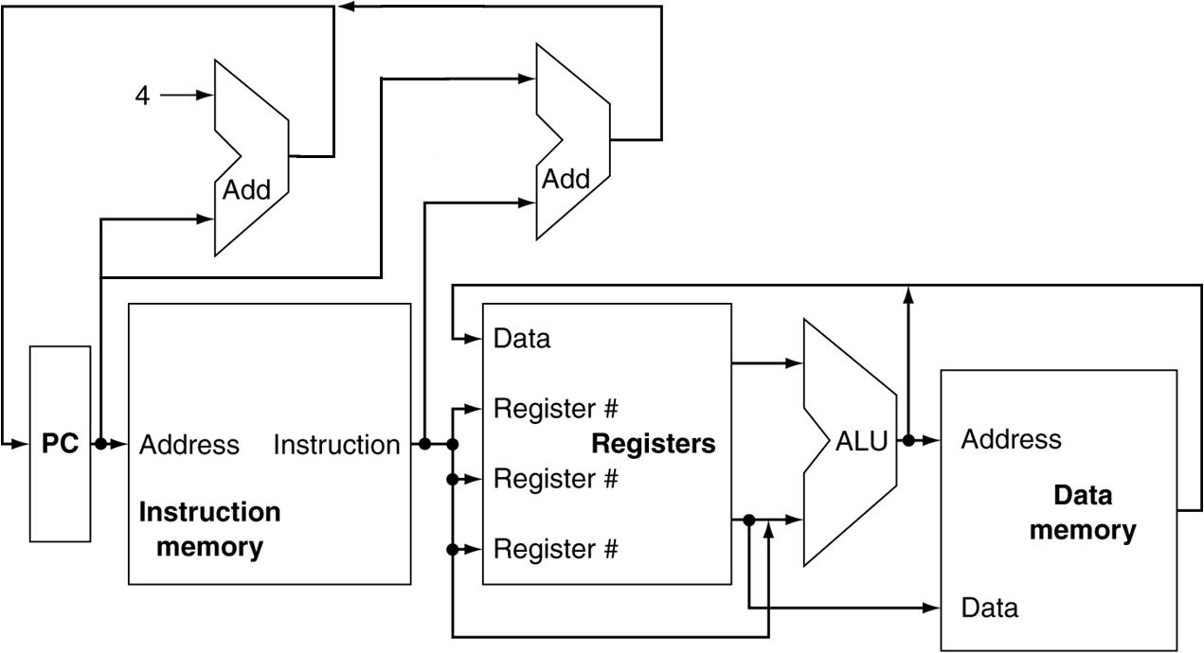
CPU Overview

Slide 5
Multiplexers
Can’t just join wires together
  Use multiplexers

Slide 6
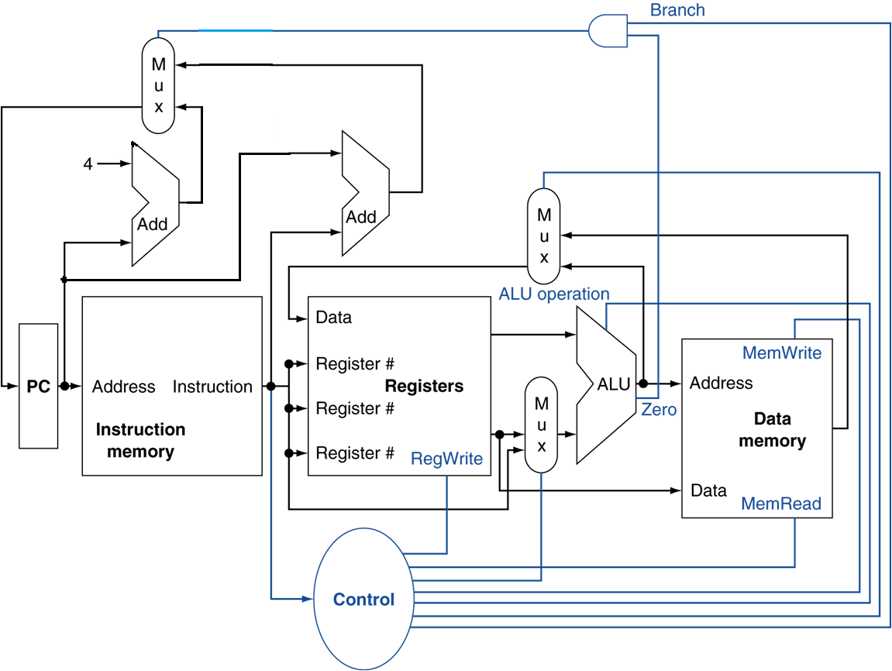
Control

Slide 7
Logic Design Basics
Information encoded in binary
  Low voltage = 0, High voltage = 1
  One wire per bit
  Multi-bit data encoded on multi-wire buses
Combinational element
  Operate on data
  Output is a function of input
State (sequential) elements
  Store information
§4.2 Logic Design Conventions

Slide 8
Combinational Elements
AND-gate
  Y = A & B
Adder
  Y = A + B
A
+
Y
B
A
Y
B
Arithmetic/Logic Unit
  Y = F(A, B)
Multiplexer
  Y = S ? I1 : I0
A
I0
M
u
x
Y
Y
ALU
I1
B
S
F

Slide 9
Sequential Elements
Register: stores data in a circuit
  Uses a clock signal to determine when to update the stored value
  Edge-triggered: update when Clk changes from 0 to 1
Clk
D
Q
D
Clk
Q

Slide 10
Sequential Elements
Register with write control
  Only updates on clock edge when write control input is 1
  Used when stored value is required later
Clk
D
Q
Write
Write
D
Clk
Q

Slide 11
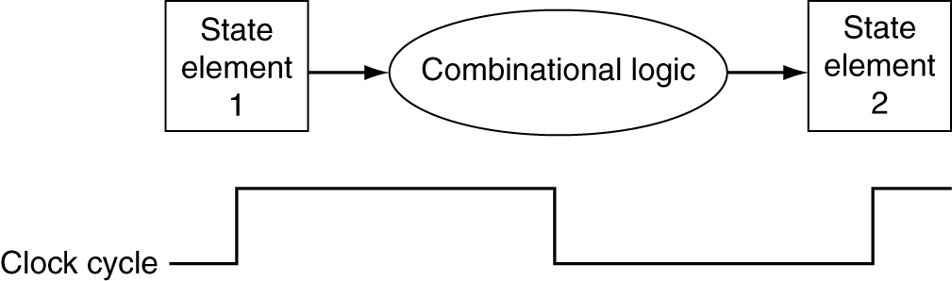
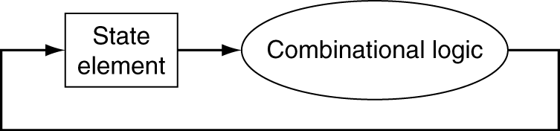
Clocking Methodology
Combinational logic transforms data during clock cycles
  Between clock edges
  Input from state elements, output to state element
  Longest delay determines clock period

Slide 12
Building a Datapath
Datapath
  Elements that process data and addresses
  in the CPU
    Registers, ALUs, mux’s, memories, …
We will build a RISC-V datapath incrementally
  Refining the overview design
§4.3 Building a Datapath

Slide 13
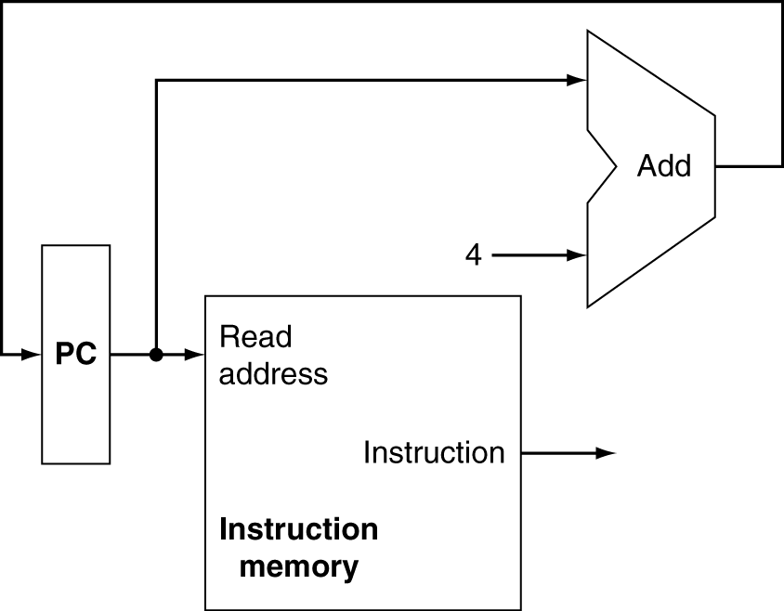
Instruction Fetch
Increment by 4 for next instruction
32-bit register

Slide 14
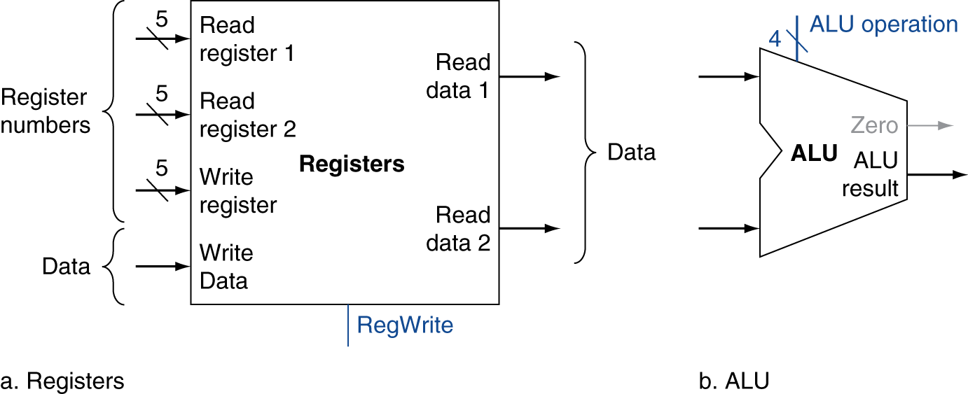
R-Format Instructions
Read two register operands
Perform arithmetic/logical operation
Write register result

Slide 15
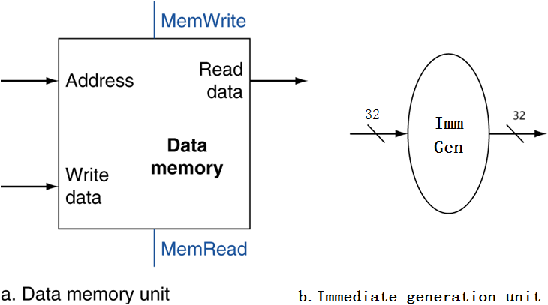
Load/Store Instructions
Read register operands
Calculate address using 12-bit offset
  Use ALU, but sign-extend offset
Load: Read memory and update register
Store: Write register value to memory

Slide 16
Branch Instructions
Read register operands
Compare operands
  Use ALU, subtract and check Zero output
Calculate target address
  Sign-extend displacement
  Shift left 1 places
  Add to PC
    Already calculated by instruction fetch

Slide 17
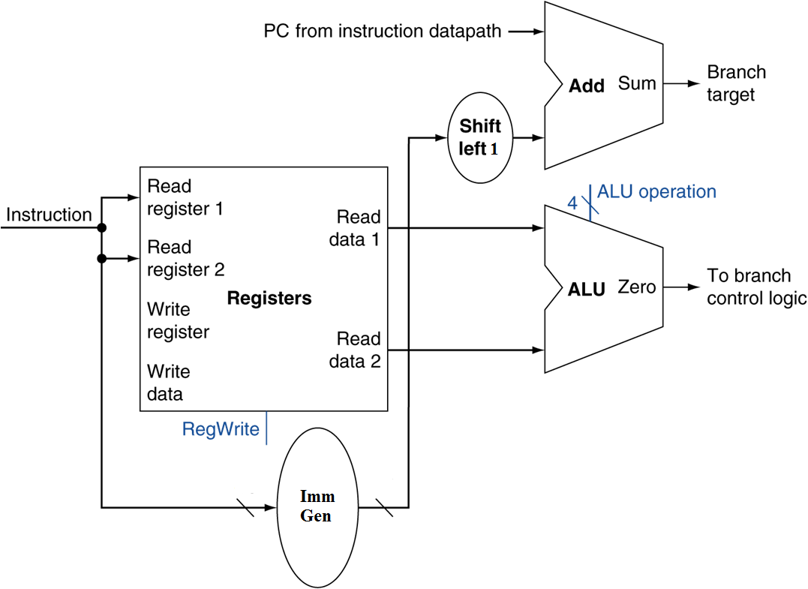
Branch Instructions
Just
re-routes wires
Sign-bit wire replicated

Slide 18
Composing the Elements
First-cut data path does an instruction in one clock cycle
  Each datapath element can only do one function at a time
  Hence, we need separate instruction and data memories
Use multiplexers where alternate data sources are used for different instructions

Slide 19
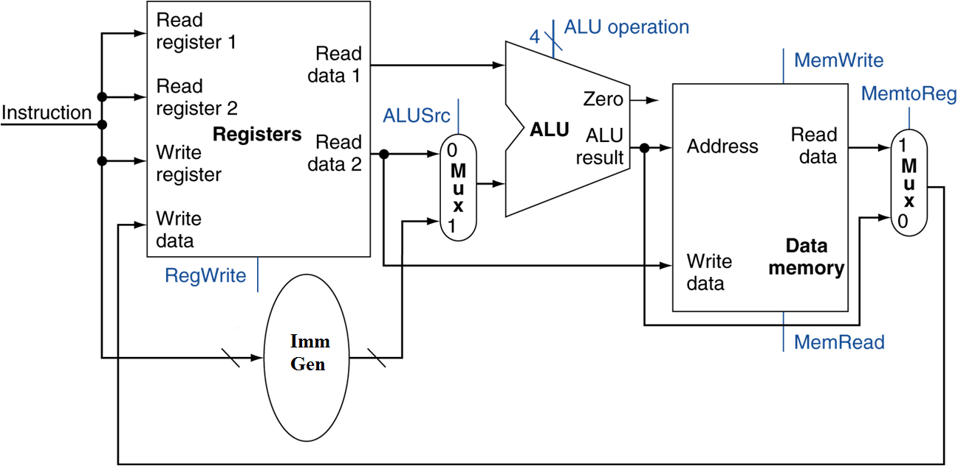

Slide 20
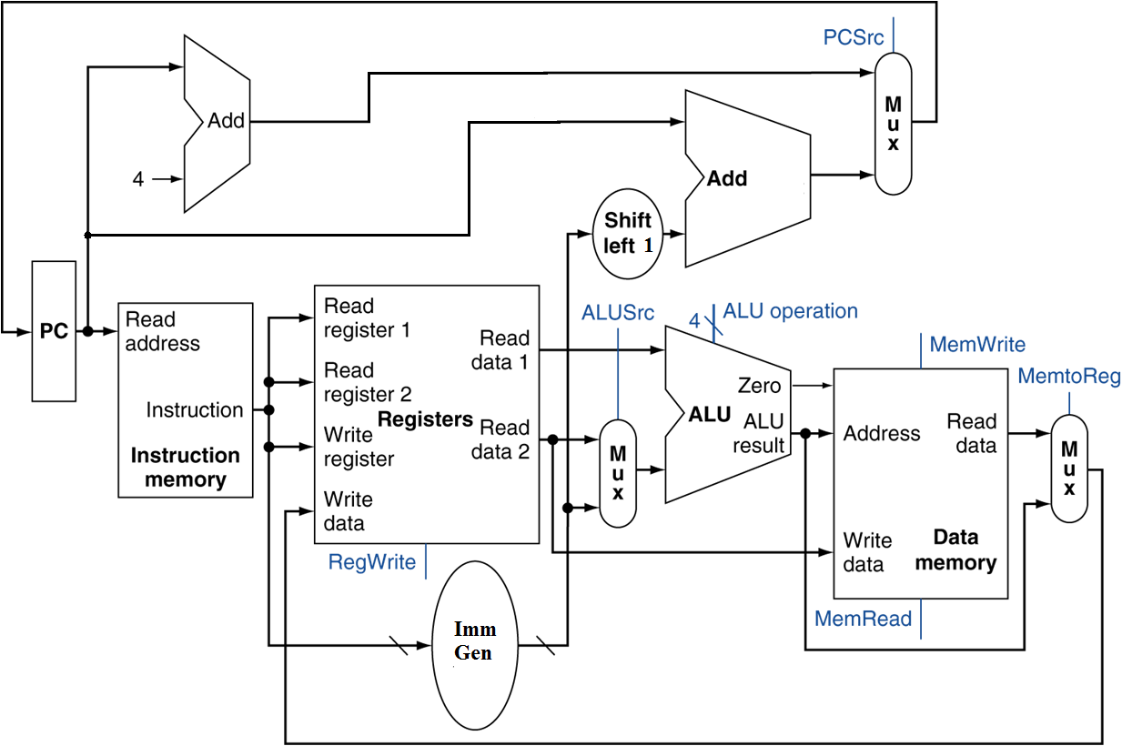
Full Datapath

Slide 21
ALU Control
ALU used for
  Load/Store: F = add
  Branch: F = subtract
  R-type: F depends on funct field
§4.4 A Simple Implementation Scheme
ALU control lines | Function
0000 | AND
0001 | OR
0010 | add
0110 | subtract

Slide 22
ALU Control
Assume 2-bit ALUOp derived from opcode
  Combinational logic derives ALU control
opcode | ALUOp | Operation | Funct7 field | Funct3 field | ALU action | ALU control
lw | 00 | load word | XXXXXXX | XXX | add | 0010
sw | 00 | store word | XXXXXXX | XXX | add | 0010
beq | 01 | branch if equal | XXXXXXX | XXX | subtract | 0110
R-type | 10 | add | 0000000 | 000 | add | 0010
 |  | subtract | 0100000 | 000 | subtract | 0110
 |  | AND | 0000000 | 111 | AND | 0000
 |  | OR | 0000000 | 110 | OR | 0001

Slide 23
The Main Control Unit
Control signals derived from instruction
31:25
24:20
19:15
14:12
11:7
6:0
R-type:
funct7
rs2
rs1
funct3
rd
opcode
I-type:
Imm[11:0]
rs1
funct3
rd
opcode
S-type:
Imm[11:5]
rs2
rs1
funct3
Imm[4:0]
opcode
SB-type:
Imm[12,10:5]
rs2
rs1
funct3
Imm[4:1,11]
opcode
sign-extend and add
read, except for load
always read
write for R-type and load
opcode
for main control

Slide 24
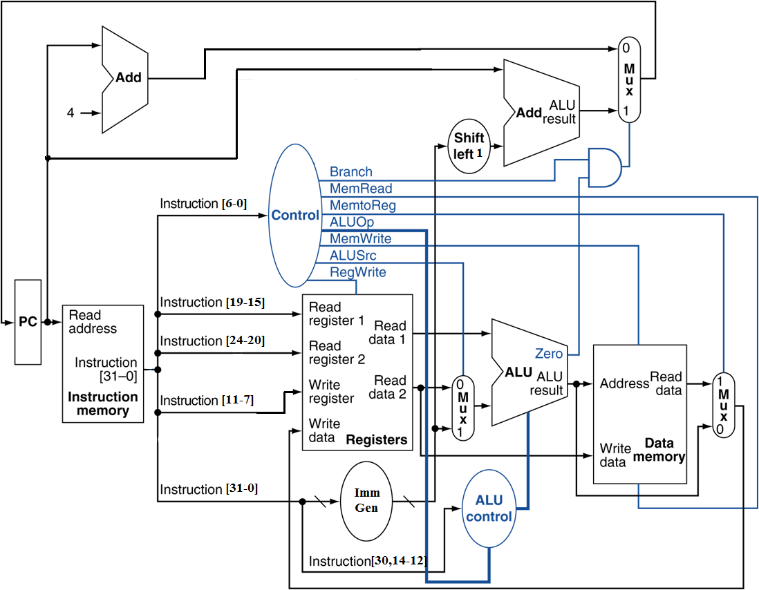
Datapath With Control

Slide 25
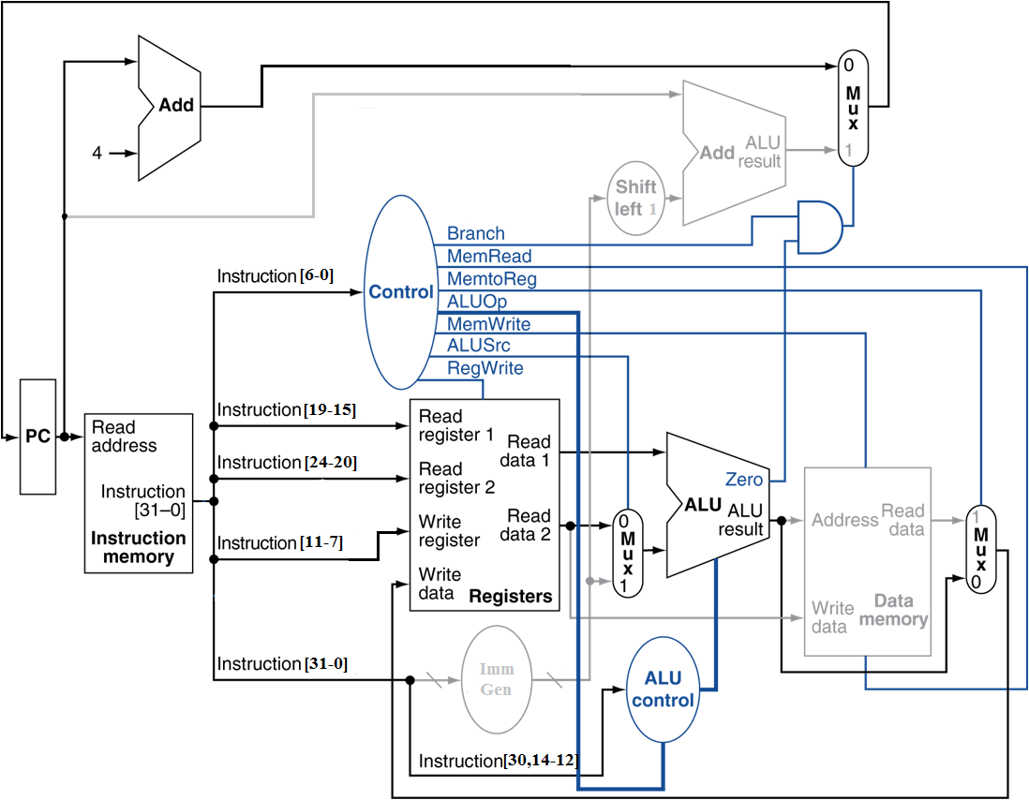
R-Type Instruction

Slide 26
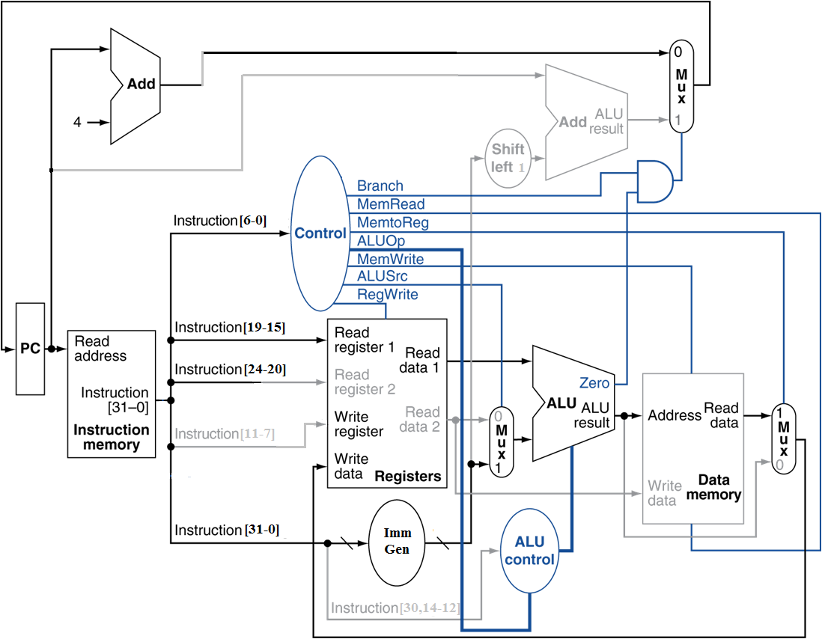
Load Instruction

Slide 27
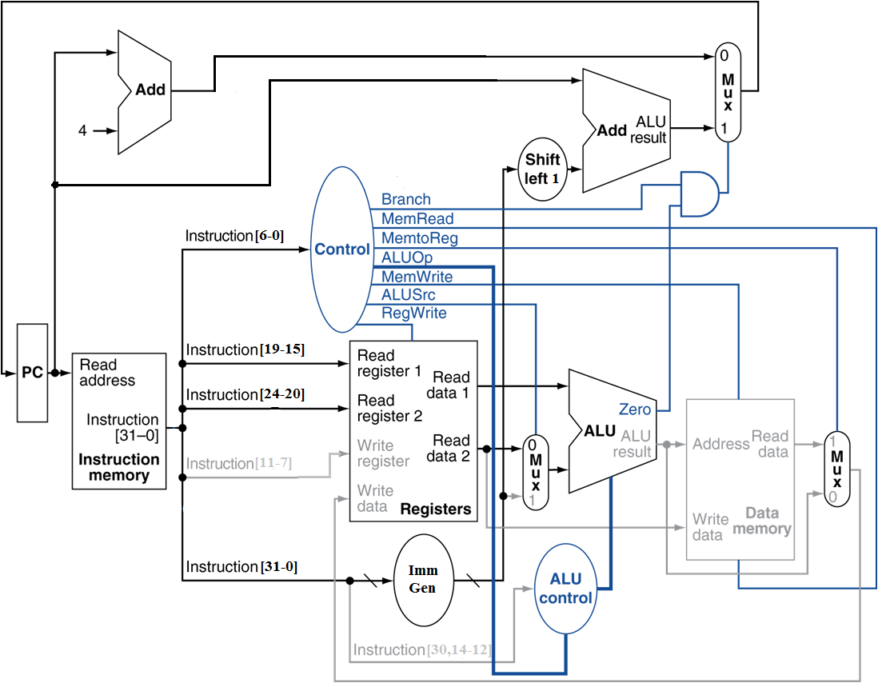
Branch-on-Equal Instruction

Slide 28
Performance Issues
Longest delay determines clock period
  Critical path: load instruction
  Instruction memory → register file → ALU → data memory → register file
Not feasible to vary period for different instructions
Violates design principle
  Making the common case fast
We will improve performance by pipelining

Slide 29
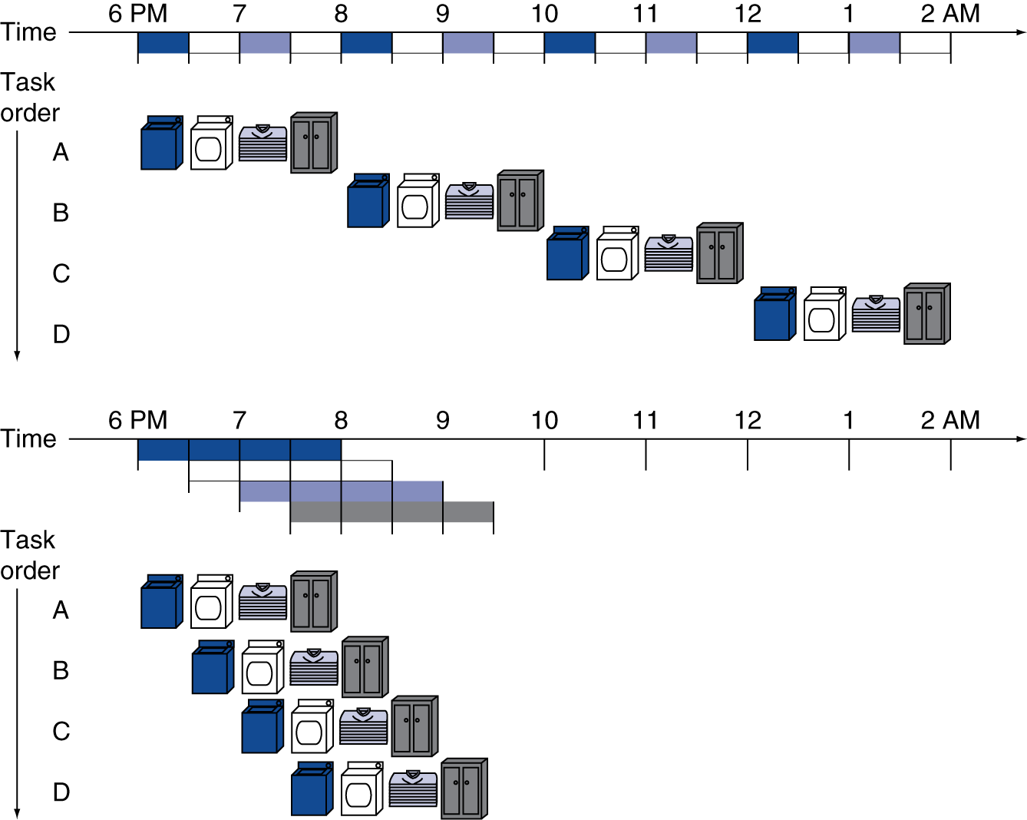
Pipelining Analogy
Pipelined laundry: overlapping execution
  Parallelism improves performance
§4.6 An Overview of Pipelining
Four loads:
  Speedup
  = 8/3.5 = 2.3
Non-stop:
  Speedup
  = 2n/(0.5n + 1.5) ≈ 4
  = number of stages

Slide 30
RISC-V Pipeline
Five stages, one step per stage
  IF: Instruction fetch from memory
  ID: Instruction decode & register read
  EX: Execute operation or calculate address
  MEM: Access data memory operand
  WB: Write result back to register

Slide 31
Pipeline Performance
Assume time for stages is
  100ps for register read or write
  200ps for other stages
Compare pipelined datapath with single-cycle datapath
Instr | Instr fetch | Register read | ALU op | Memory access | Register write | Total time
ld | 200ps | 100 ps | 200ps | 200ps | 100 ps | 800ps
sd | 200ps | 100 ps | 200ps | 200ps |  | 700ps
R-format | 200ps | 100 ps | 200ps |  | 100 ps | 600ps
beq | 200ps | 100 ps | 200ps |  |  | 500ps

Slide 32
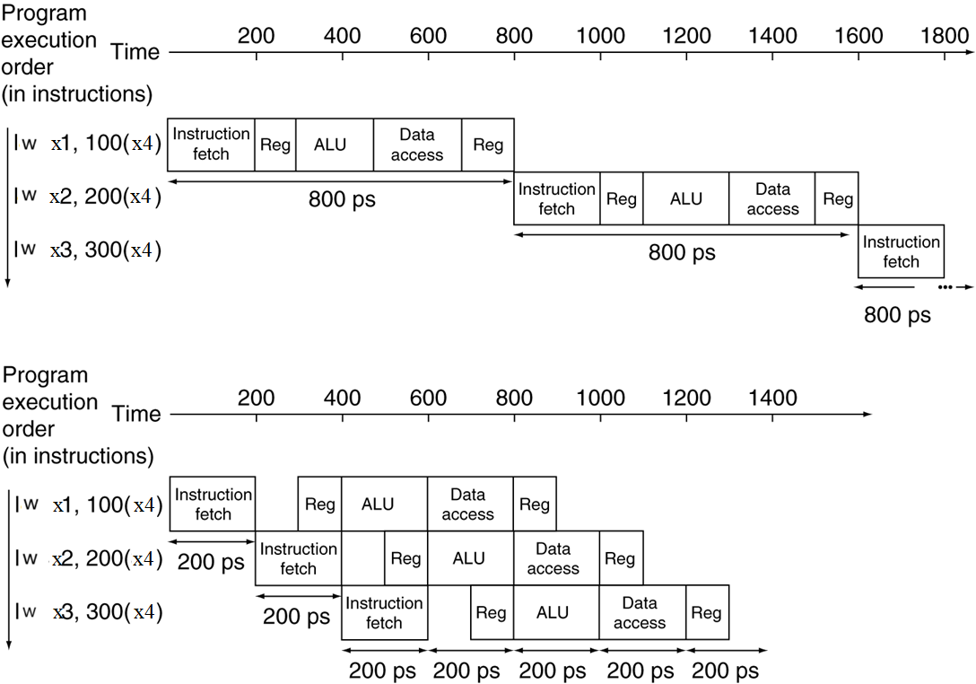
Pipeline Performance
Single-cycle (T_{c}= 800ps)
Pipelined (T_{c}= 200ps)

Slide 33
Pipeline Speedup
If all stages are balanced
  i.e., all take the same time
  Time between instructions_{pipelined}
  = Time between instructions_{nonpipelined}
  Number of stages
If not balanced, speedup is less
Speedup due to increased throughput
  Latency (time for each instruction) does not decrease

Slide 34
Pipelining and ISA Design
RISC-V ISA designed for pipelining
  All instructions are 32-bits
    Easier to fetch and decode in one cycle
    c.f. x86: 1- to 17-byte instructions
  Few and regular instruction formats
    Can decode and read registers in one step
  Load/store addressing
    Can calculate address in 3rd stage, access memory in 4th stage

Slide 35
Hazards
Situations that prevent starting the next instruction in the next cycle
Structure hazards
  A required resource is busy
Data hazard
  Need to wait for previous instruction to complete its data read/write
Control hazard
  Deciding on control action depends on previous instruction

Slide 36
Structure Hazards
Conflict for use of a resource
In RISC-V pipeline with a single memory
  Load/store requires data access
  Instruction fetch would have to stall for that cycle
    Would cause a pipeline “bubble”
Hence, pipelined datapaths require separate instruction/data memories
  Or separate instruction/data caches

Slide 37
A Single Memory Would Be a Structural Hazard
Time (clock cycles)
Reading data from memory
lw
Mem
Reg
ALU
Mem
Reg
I
n
s
t
r.
O
r
d
e
r
Inst 1
Mem
Reg
ALU
Mem
Reg
Inst 2
Mem
Reg
ALU
Mem
Reg
Inst 3
Mem
Reg
ALU
Mem
Reg
Inst 4
Reading instruction from memory
Mem
Reg
ALU
Mem
Reg
Fix with separate instr and data memories (I$ and D$)

Slide 38
How About Register File Access?
Time (clock cycles)
Fix register file access hazard by doing reads in the second half of the cycle and writes in the first half
add x1,
IM
Reg
ALU
DM
Reg
I
n
s
t
r.
O
r
d
e
r
Inst 1
IM
Reg
ALU
DM
Reg
Inst 2
IM
Reg
ALU
DM
Reg
add x2,x1,
IM
Reg
ALU
DM
Reg
clock edge that controls loading of pipeline state registers
clock edge that controls register writing
Notes:
Define register reads to occur in the second half of the cycle and register writes in the first half

Slide 39
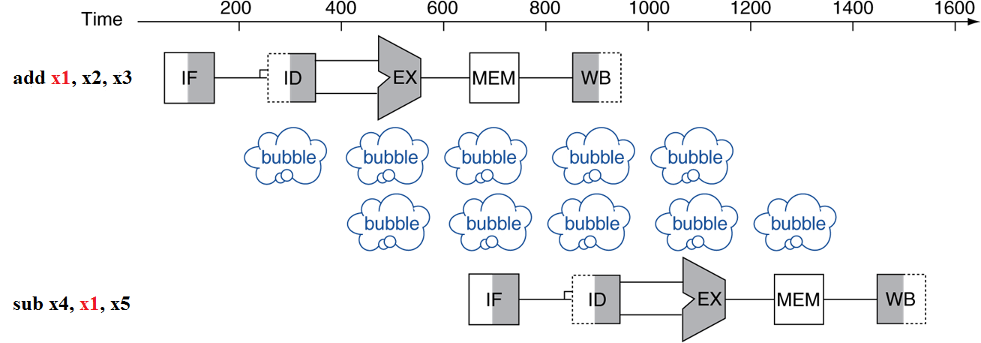
Data Hazards
An instruction depends on completion of data access by a previous instruction
  add x1, x2, x3
  sub x4, x1, x5

Slide 40
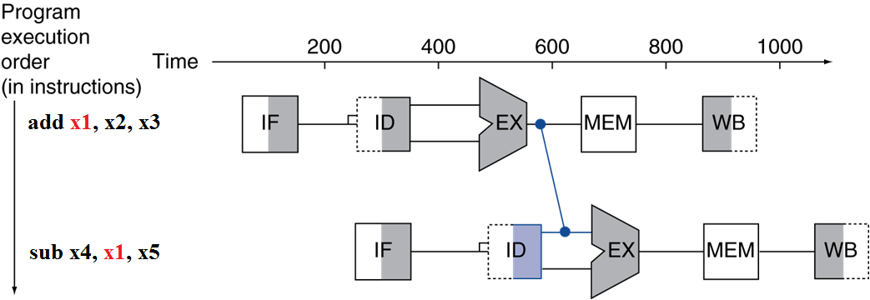
Forwarding (aka Bypassing)
Use result when it is computed
  Don’t wait for it to be stored in a register
  Requires extra connections in the datapath

Slide 41
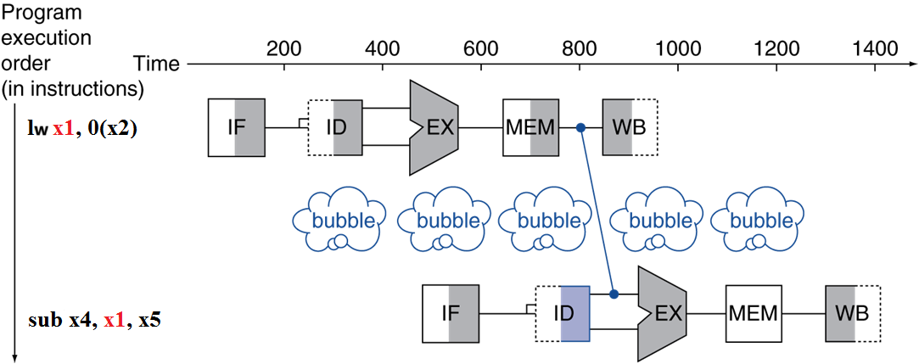
Load-Use Data Hazard
Can’t always avoid stalls by forwarding
  If value not computed when needed
  Can’t forward backward in time!

Slide 42
Code Scheduling to Avoid Stalls
Reorder code to avoid use of load result in the next instruction
C code for A = B + E; C = B + F;
lw x1, 0(x31)
lw x2, 4(x31)
add x3, x1, x2
sw x3, 12(x31)
lw x4, 8(x31)
add x5, x1, x4
sw x5, 16(x31)
lw x1, 0(x31)
lw x2, 4(x31)
lw x4, 8(x31)
add x3, x1, x2
sw x3, 12(x31)
add x5, x1, x4
sw x5, 16(x31)
stall
stall
9 cycles
7 cycles

Slide 43
Control Hazards
Branch determines flow of control
  Fetching next instruction depends on branch outcome
  Pipeline can’t always fetch correct instruction
    Still working on ID stage of branch
In RISC-V pipeline
  Need to compare registers and compute target early in the pipeline
  Add hardware to do it in ID stage

Slide 44
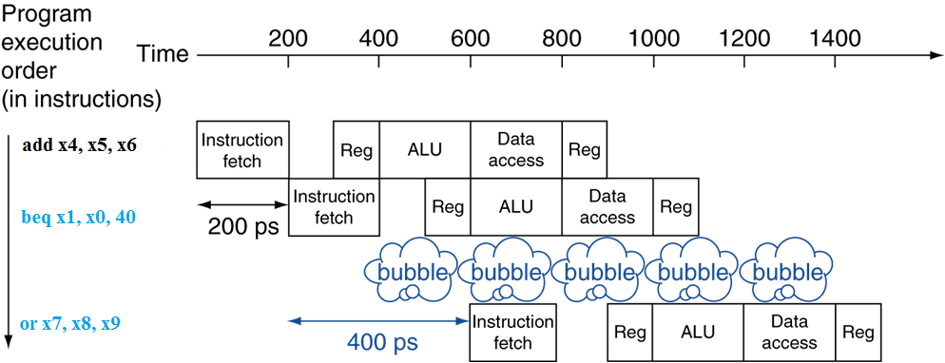
Stall on Branch
Wait until branch outcome determined before fetching next instruction

Slide 45
Branch Prediction
Longer pipelines can’t readily determine branch outcome early
  Stall penalty becomes unacceptable
Predict outcome of branch
  Only stall if prediction is wrong
In pipeline
  Can predict branches not taken
  Delayed branch (MIPS)
  Others

Slide 46
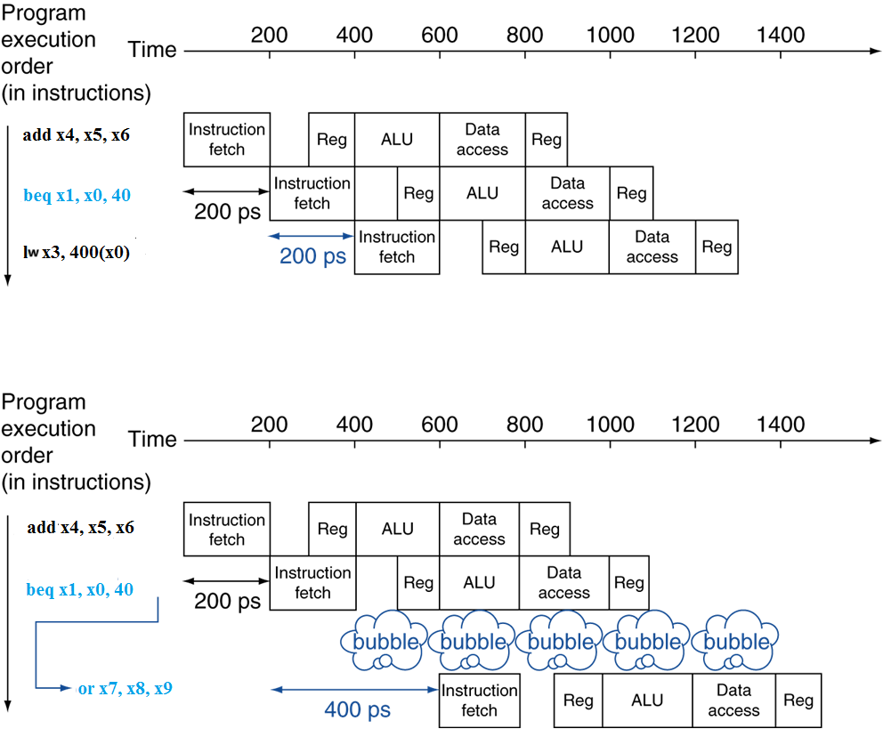
RISC-V with Predict Not Taken
Prediction correct
Prediction incorrect

Slide 47
More-Realistic Branch Prediction
Static branch prediction
  Based on typical branch behavior
  Example: loop and if-statement branches
    Predict backward branches taken
    Predict forward branches taken
Dynamic branch prediction
  Hardware measures actual branch behavior
    e.g., record recent history of each branch
  Assume future behavior will continue the trend
    When wrong, stall while re-fetching, and update history

Slide 48
Pipeline Summary
The BIG Picture
Pipelining improves performance by increasing instruction throughput
  Executes multiple instructions in parallel
  Each instruction has the same latency
Subject to hazards
  Structure, data, control
Instruction set design affects complexity of pipeline implementation

Slide 49
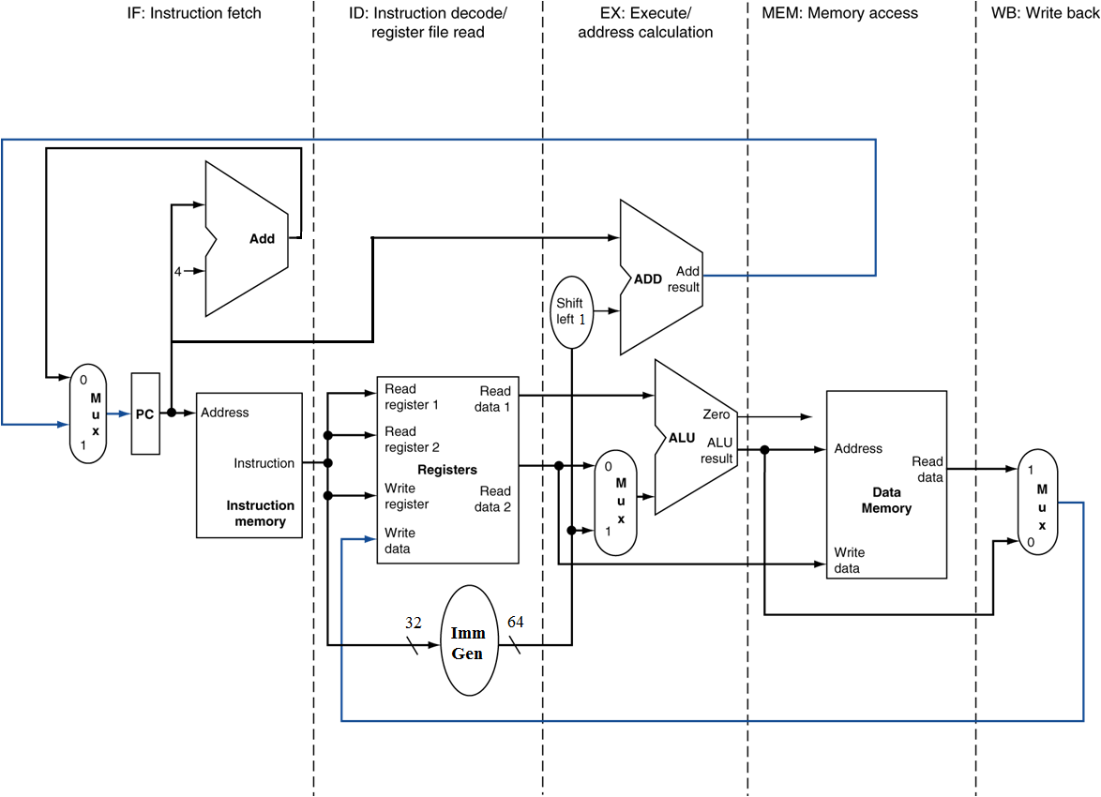
RISC-V Pipelined Datapath
§4.7 Pipelined Datapath and Control
MEM
Right-to-left flow leads to hazards
WB

Slide 50
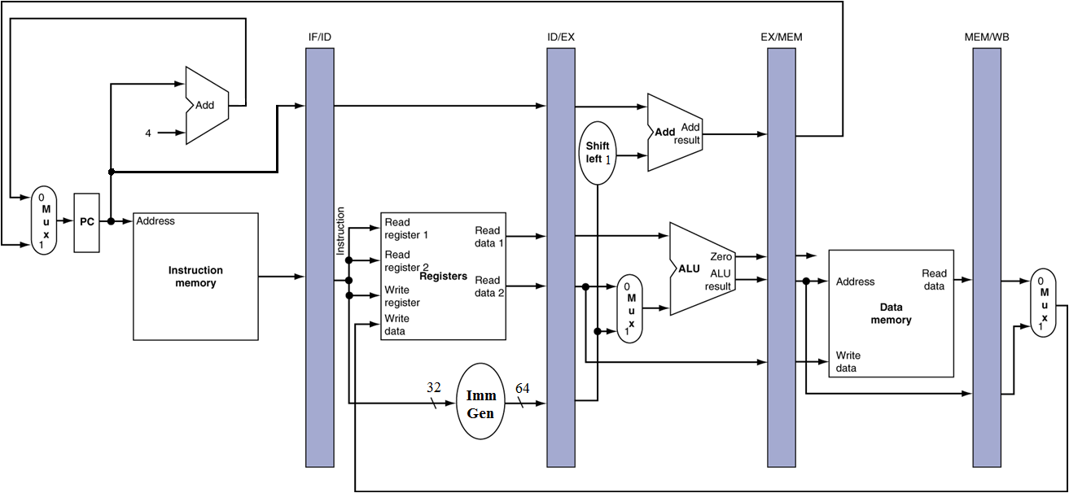
Pipeline registers
Need registers between stages
  To hold information produced in previous cycle

Slide 51
Pipeline Operation
Cycle-by-cycle flow of instructions through the pipelined datapath
  “Single-clock-cycle” pipeline diagram
    Shows pipeline usage in a single cycle
    Highlight resources used
  c.f. “multi-clock-cycle” diagram
    Graph of operation over time
We’ll look at “single-clock-cycle” diagrams for load & store

Slide 52
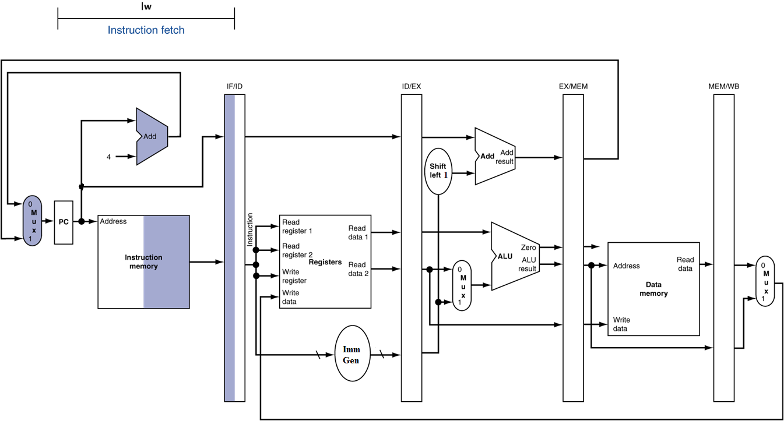
IF for Load, Store, …

Slide 53
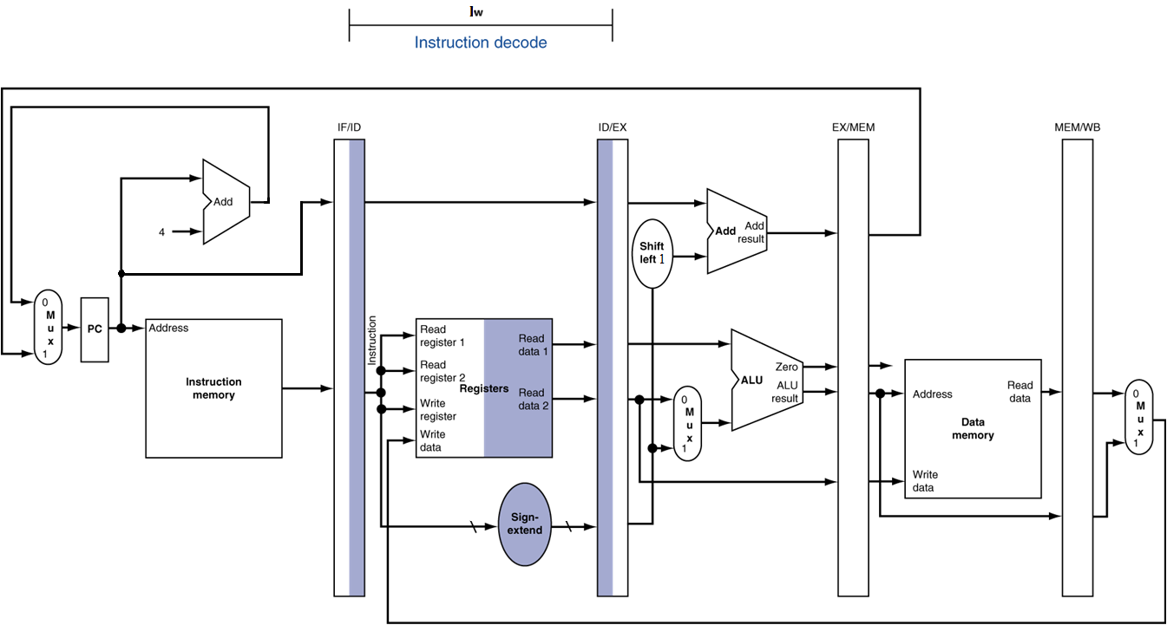
ID for Load, Store, …

Slide 54
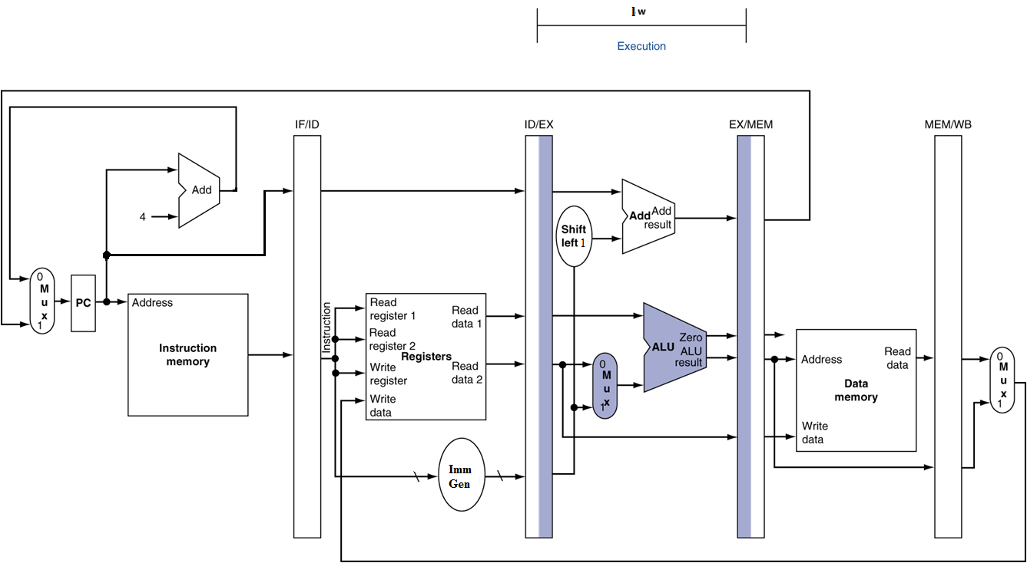
EX for Load

Slide 55
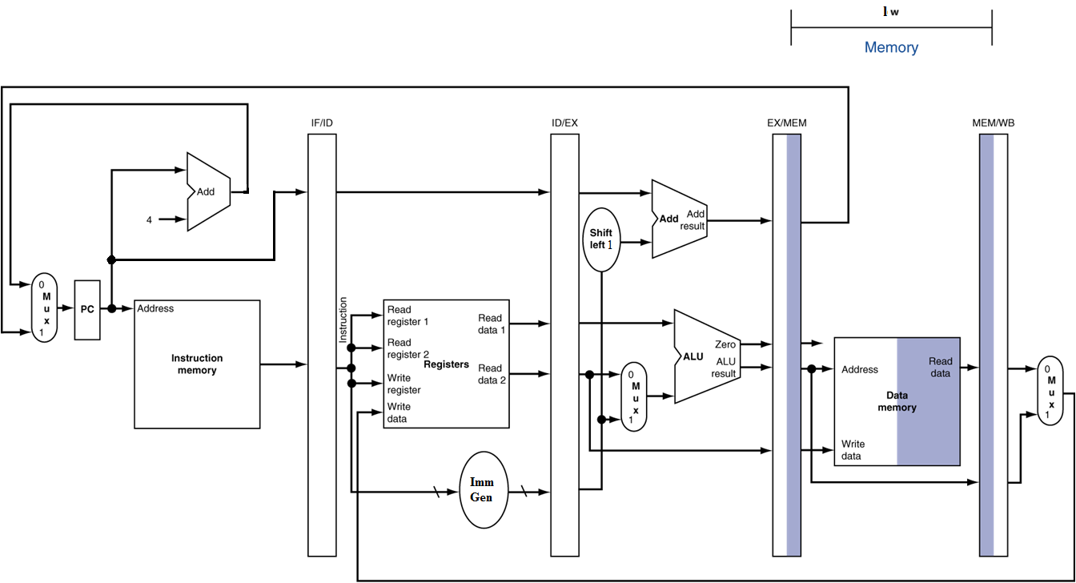
MEM for Load

Slide 56
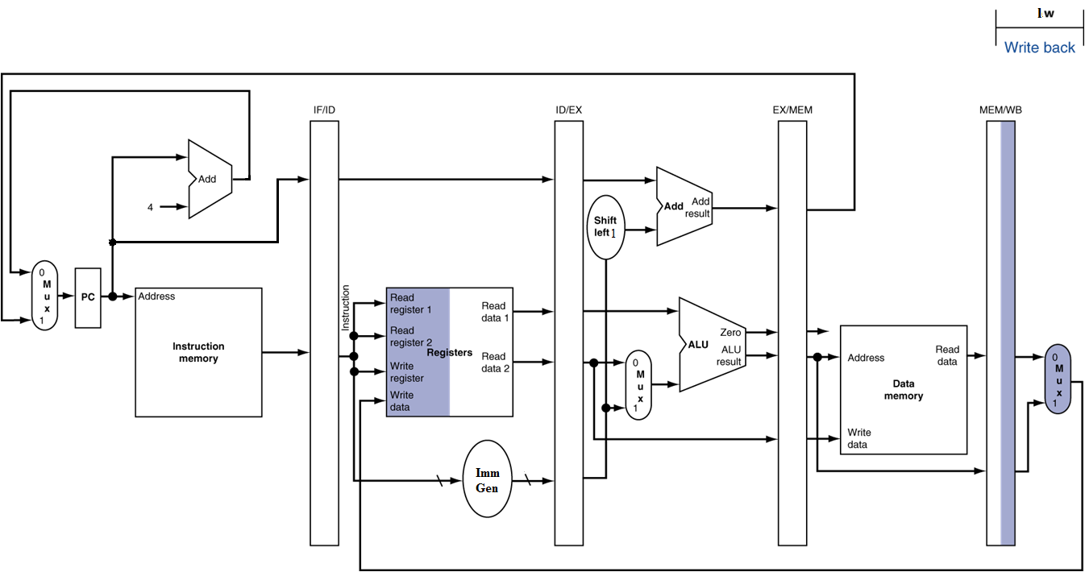
WB for Load
Wrong
register
number

Slide 57
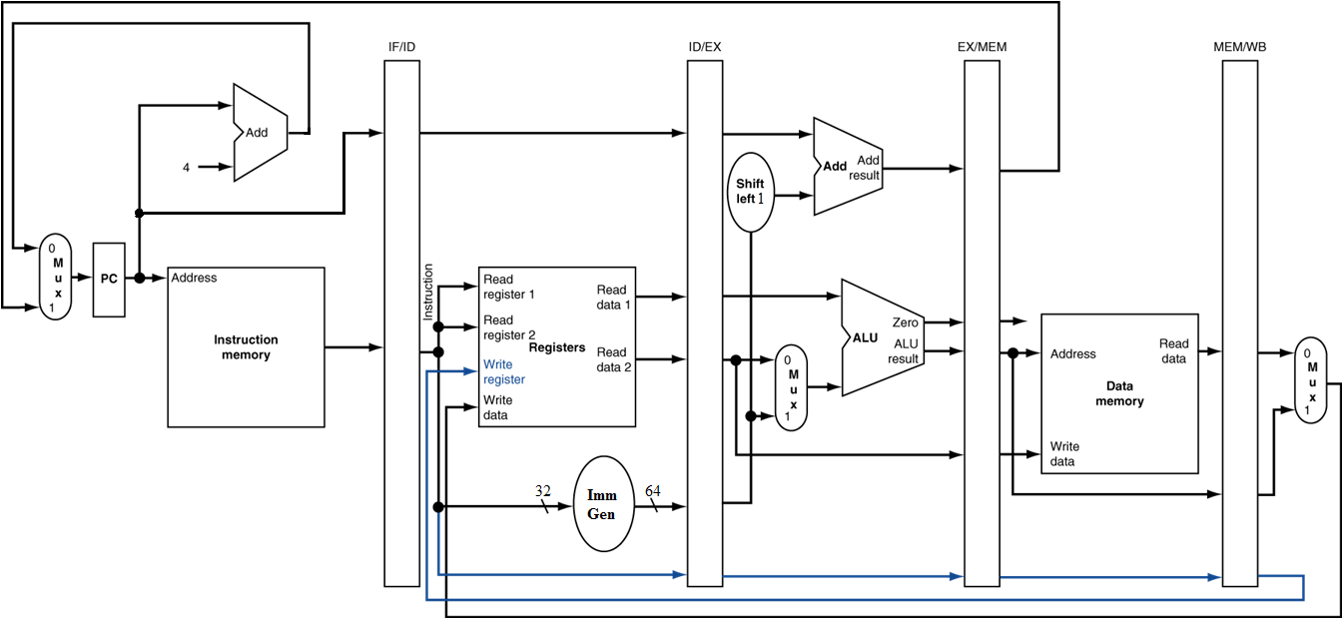
Corrected Datapath for Load

Slide 58

EX for Store

Slide 59
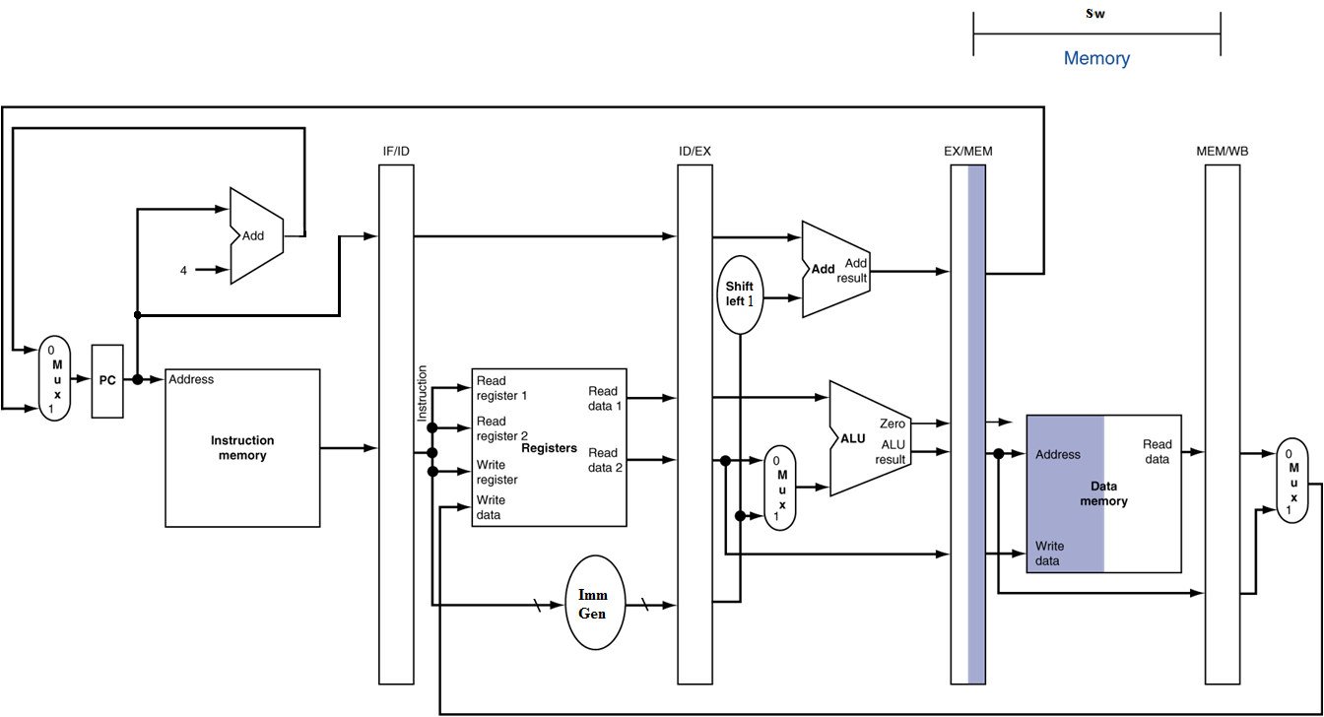
MEM for Store

Slide 60
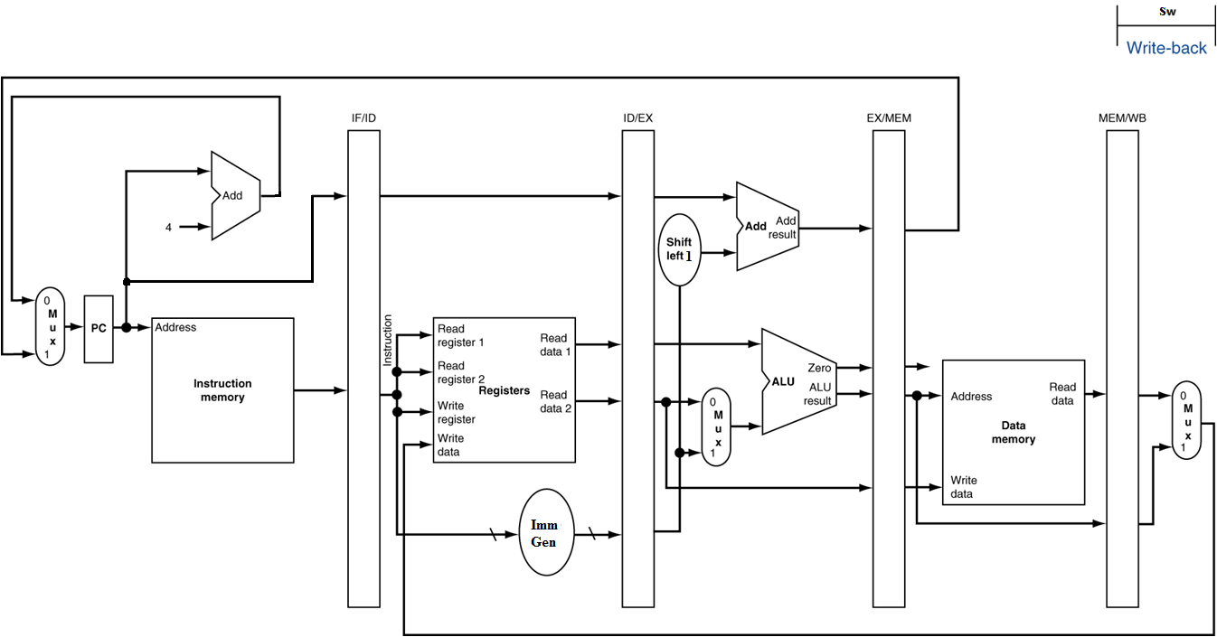
WB for Store

Slide 61
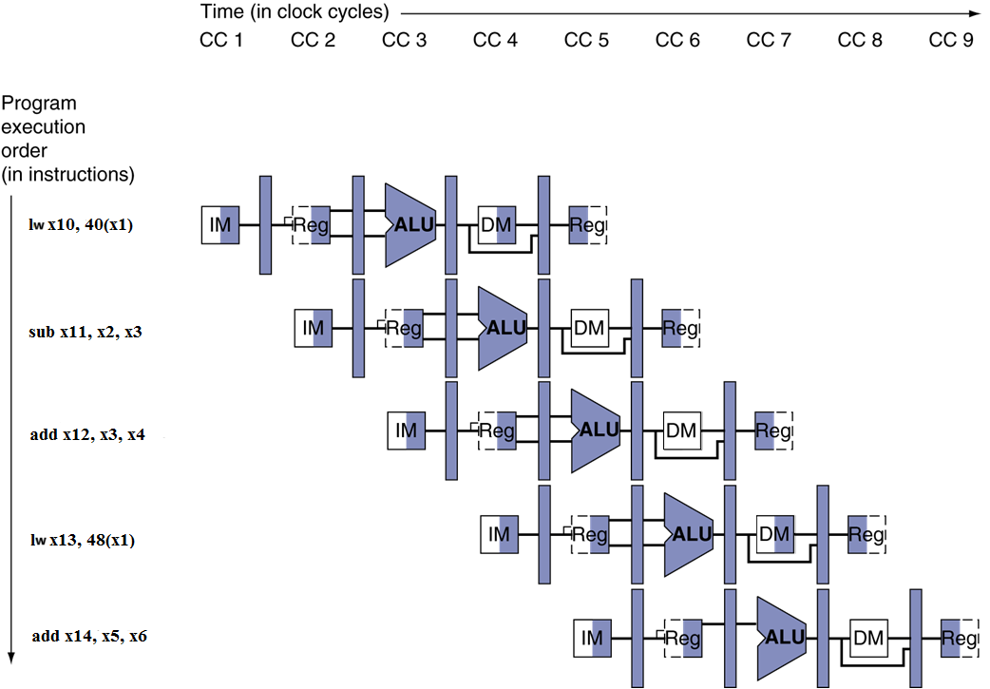
Multi-Cycle Pipeline Diagram
Form showing resource usage

Slide 62
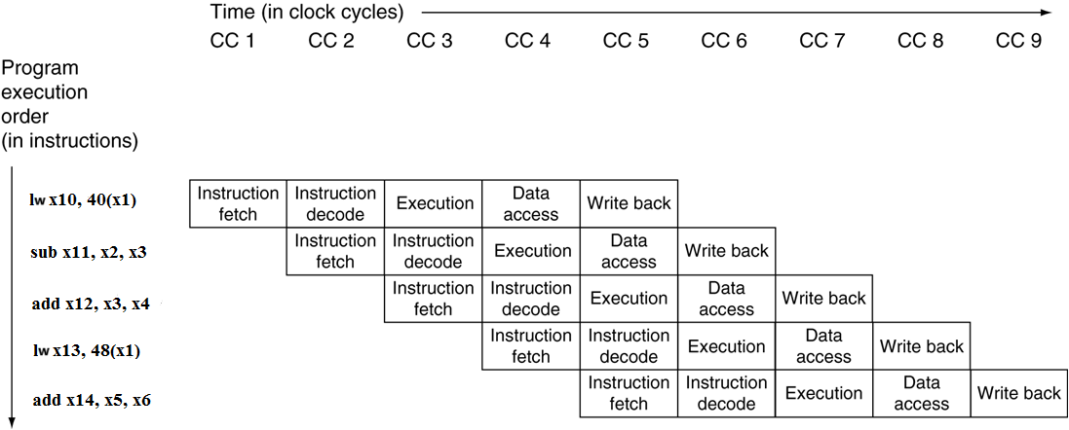
Multi-Cycle Pipeline Diagram
Traditional form

Slide 63
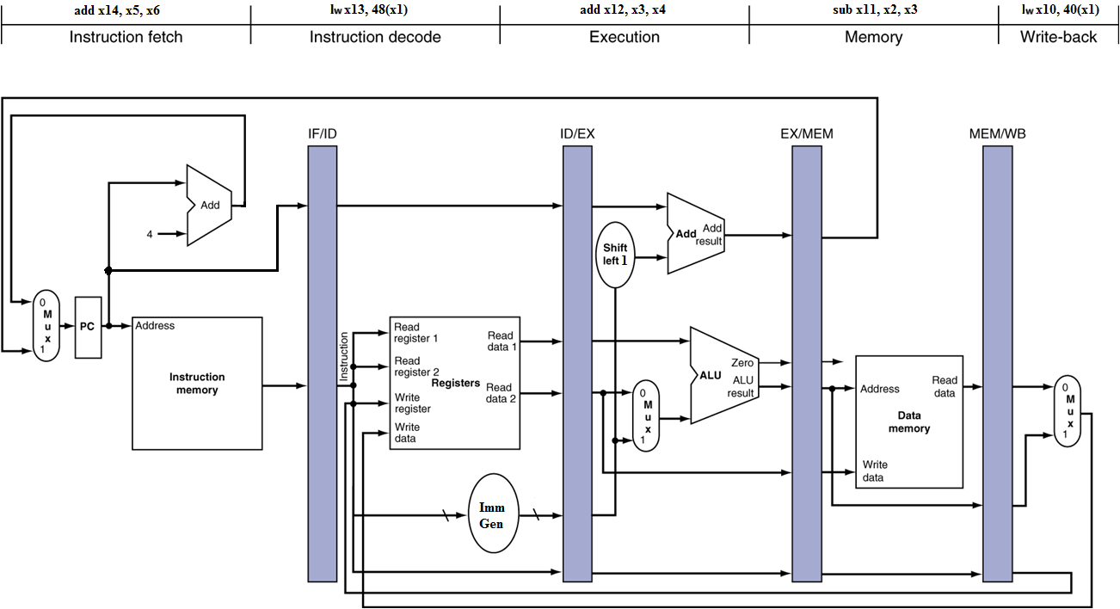
Single-Cycle Pipeline Diagram
State of pipeline in a given cycle

Slide 64
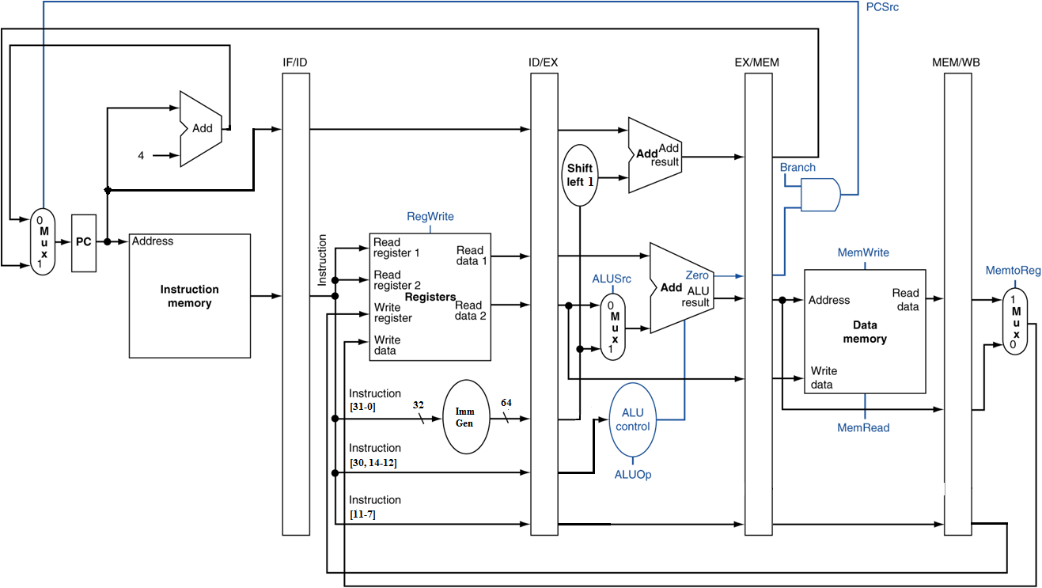
Pipelined Control (Simplified)

Slide 65
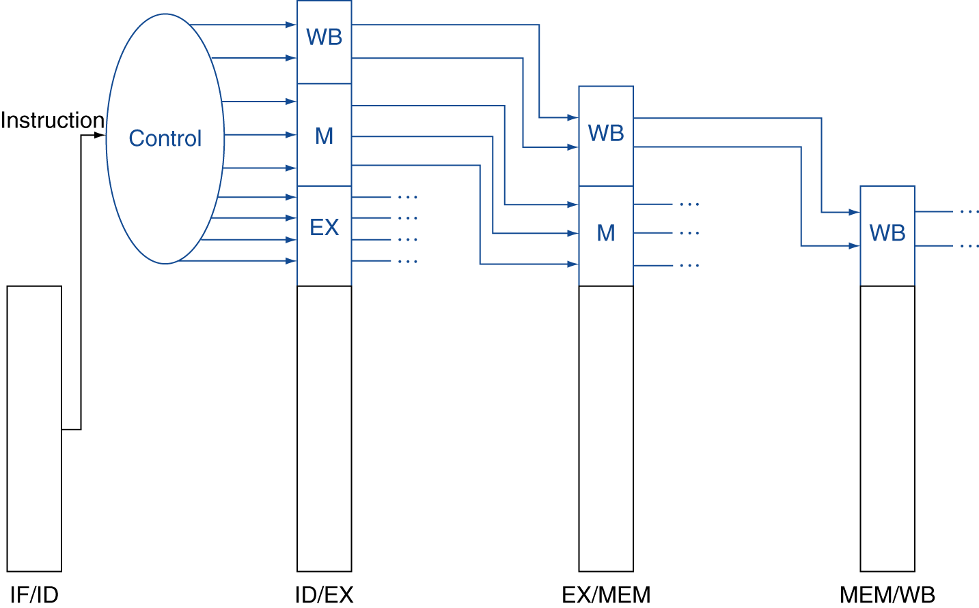
Pipelined Control
Control signals derived from instruction
  As in single-cycle implementation

Slide 66
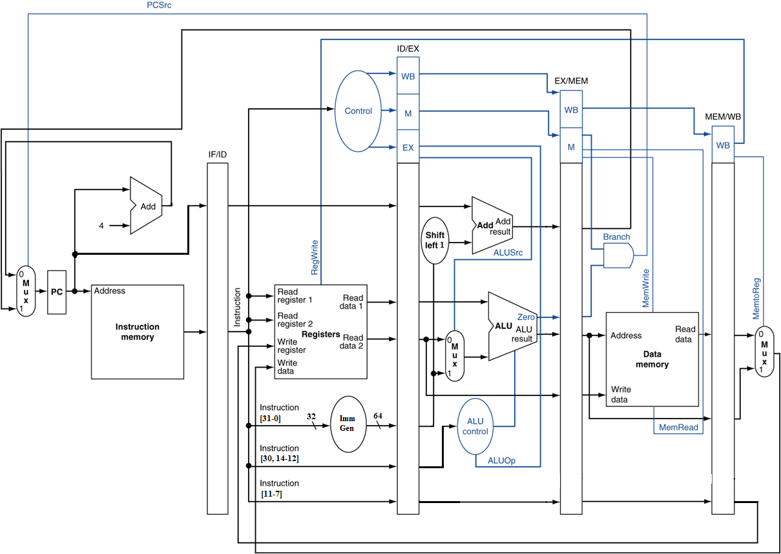
Pipelined Control

Slide 67
Data Hazards in ALU Instructions
Consider this sequence:
  sub x2, x1,x3
  and x12,x2,x5
  or x13,x6,x2
  add x14,x2,x2
  sw x15,100(x2)
We can resolve hazards with forwarding
  How do we detect when to forward?
§4.8 Data Hazards: Forwarding vs. Stalling

Slide 68
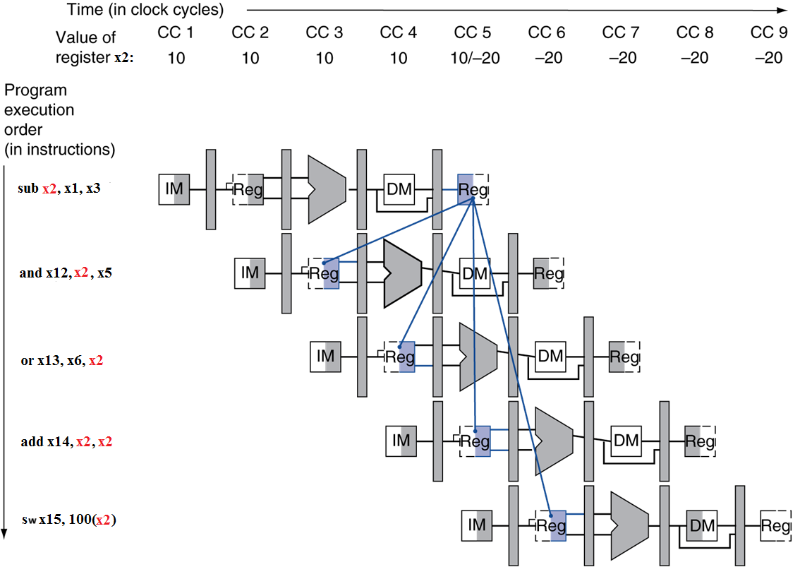
Dependencies & Forwarding

Slide 69
Detecting the Need to Forward
Pass register numbers along pipeline
  e.g., ID/EX.RegisterRs1 = register number for Rs1 sitting in ID/EX pipeline register
ALU operand register numbers in EX stage are given by
  ID/EX.RegisterRs1, ID/EX.RegisterRs2
Data hazards when
  1a. EX/MEM.RegisterRd = ID/EX.RegisterRs1
  1b. EX/MEM.RegisterRd = ID/EX.RegisterRs2
  2a. MEM/WB.RegisterRd = ID/EX.RegisterRs1
  2b. MEM/WB.RegisterRd = ID/EX.RegisterRs2
Fwd from
EX/MEM
pipeline reg
Fwd from
MEM/WB
pipeline reg

Slide 70
Detecting the Need to Forward
But only if forwarding instruction will write to a register!
  EX/MEM.RegWrite, MEM/WB.RegWrite
And only if Rd for that instruction is not x0
  EX/MEM.RegisterRd ≠ 0,
  MEM/WB.RegisterRd ≠ 0

Slide 71
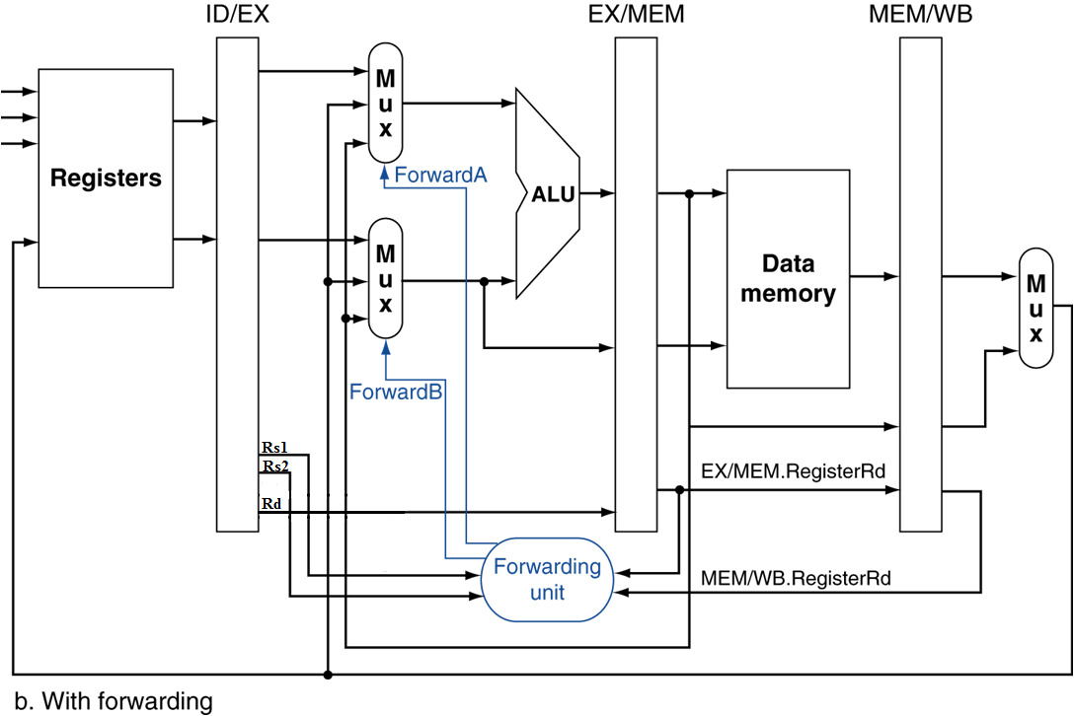
Forwarding Paths

Slide 72
Forwarding Conditions
EX hazard
  if (EX/MEM.RegWrite and (EX/MEM.RegisterRd ≠ 0)
  and (EX/MEM.RegisterRd = ID/EX.RegisterRs1))
  ForwardA = 10
  if (EX/MEM.RegWrite and (EX/MEM.RegisterRd ≠ 0)
  and (EX/MEM.RegisterRd = ID/EX.RegisterRs2))
  ForwardB = 10
MEM hazard
  if (MEM/WB.RegWrite and (MEM/WB.RegisterRd ≠ 0)
  and (MEM/WB.RegisterRd = ID/EX.RegisterRs1))
  ForwardA = 01
  if (MEM/WB.RegWrite and (MEM/WB.RegisterRd ≠ 0)
  and (MEM/WB.RegisterRd = ID/EX.RegisterRs2))
  ForwardB = 01

Slide 73
Double Data Hazard
Consider the sequence:
  add x1,x1,x2
  add x1,x1,x3
  add x1,x1,x4
Both hazards occur
  Want to use the most recent
Revise MEM hazard condition
  Only fwd if EX hazard condition isn’t true

Slide 74
Revised Forwarding Condition
MEM hazard
  if (MEM/WB.RegWrite and (MEM/WB.RegisterRd ≠ 0)
  and not (EX/MEM.RegWrite and (EX/MEM.RegisterRd ≠ 0)
  and (EX/MEM.RegisterRd = ID/EX.RegisterRs1))
  and (MEM/WB.RegisterRd = ID/EX.RegisterRs1))
  ForwardA = 01
  if (MEM/WB.RegWrite and (MEM/WB.RegisterRd ≠ 0)
  and not (EX/MEM.RegWrite and (EX/MEM.RegisterRd ≠ 0)
  and (EX/MEM.RegisterRd = ID/EX.RegisterRs2))
  and (MEM/WB.RegisterRd = ID/EX.RegisterRs2))
  ForwardB = 01

Slide 75
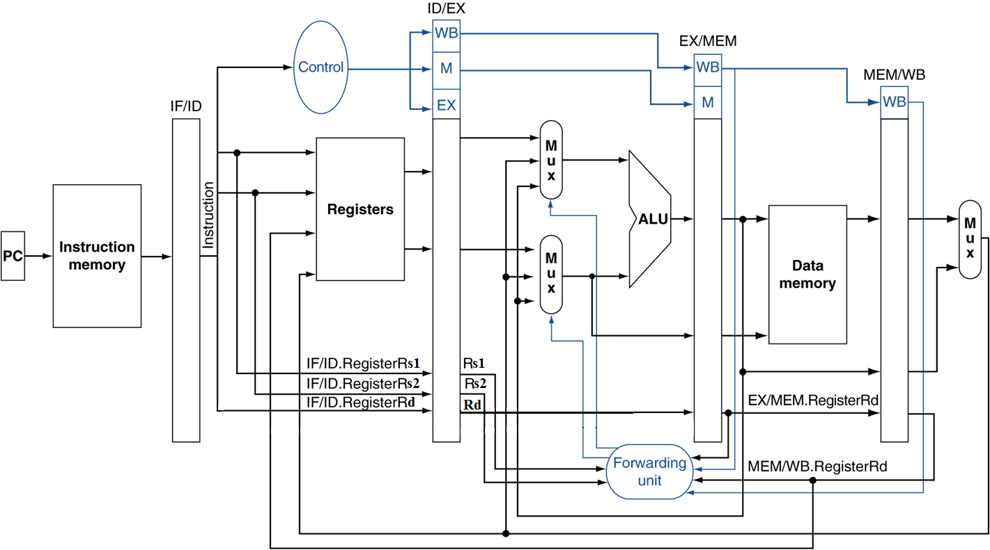
Datapath with Forwarding

Slide 76
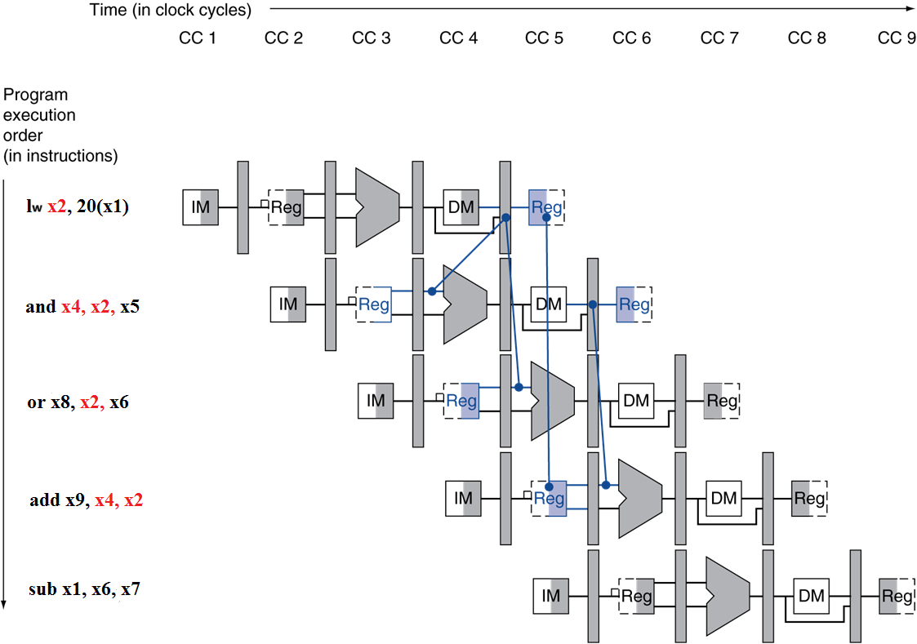
Load-Use Data Hazard
Need to stall for one cycle

Slide 77
Load-Use Hazard Detection
Check when using instruction is decoded in ID stage
ALU operand register numbers in ID stage are given by
  IF/ID.RegisterRs1, IF/ID.RegisterRs2
Load-use hazard when
  ID/EX.MemRead and
  ((ID/EX.RegisterRd = IF/ID.RegisterRs1) or
  (ID/EX.RegisterRd = IF/ID.RegisterRs2))
If detected, stall and insert bubble

Slide 78
How to Stall the Pipeline
Force control values in ID/EX register
to 0
  EX, MEM and WB do nop (no-operation)
Prevent update of PC and IF/ID register
  Using instruction is decoded again
  Following instruction is fetched again
  1-cycle stall allows MEM to read data for lw
    Can subsequently forward to EX stage

Slide 79
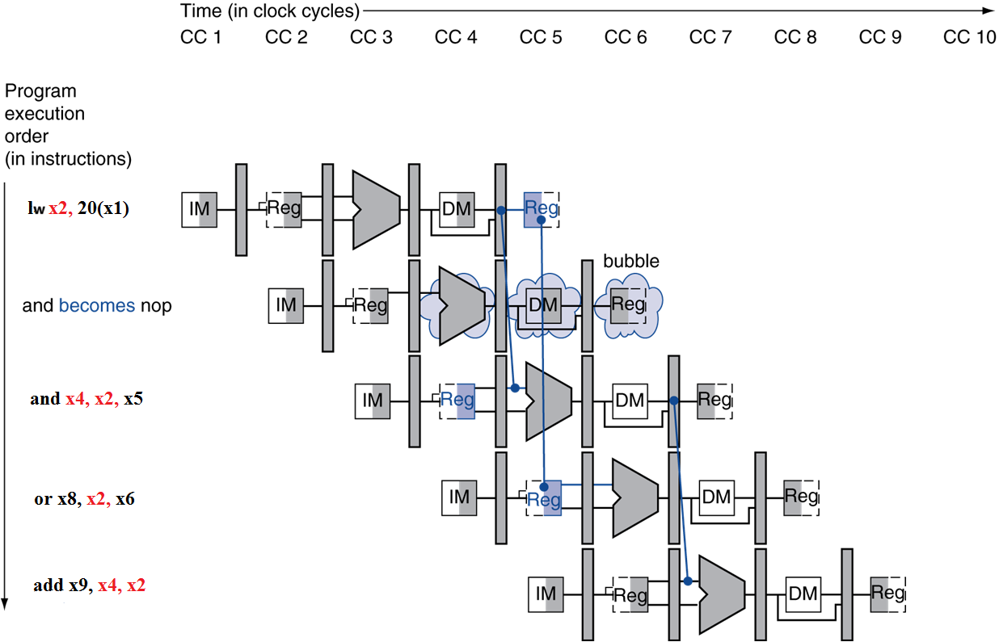
Stall/Bubble in the Pipeline
Stall inserted here

Slide 80
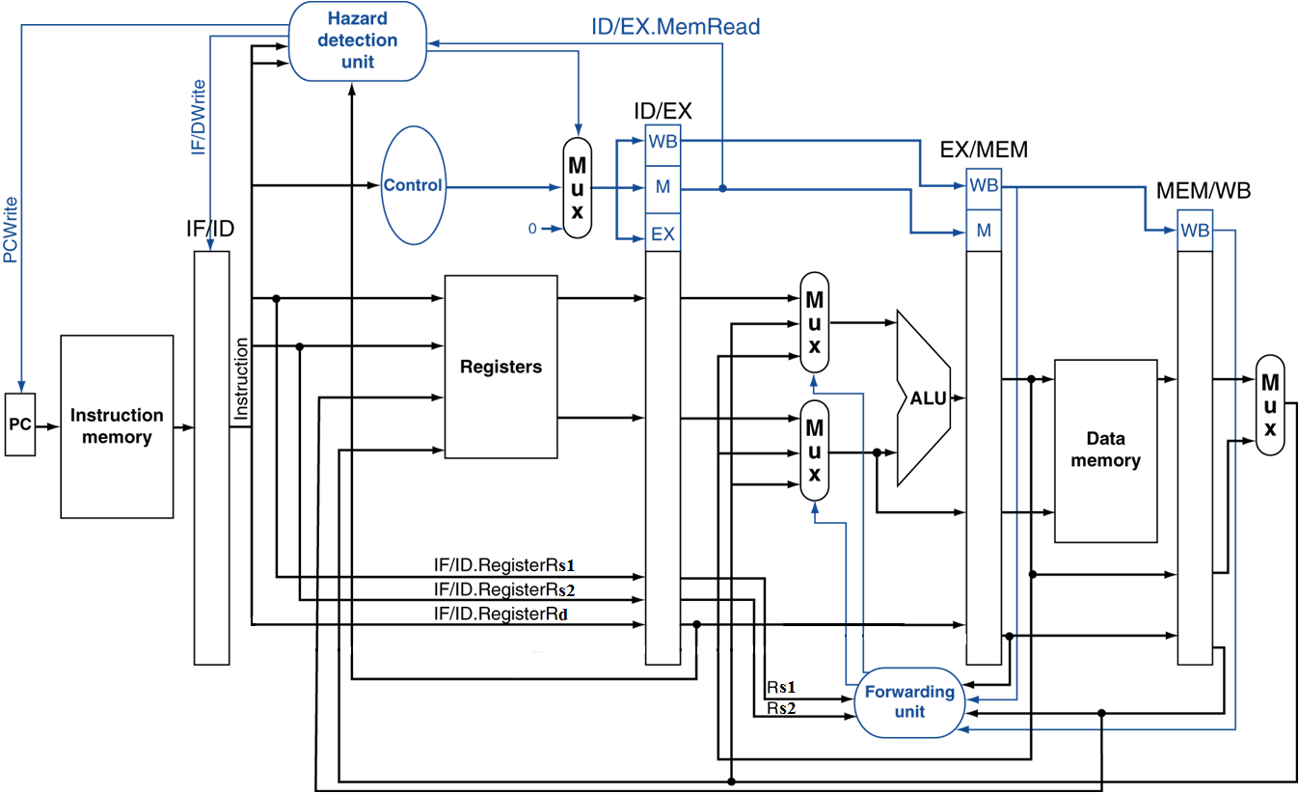
Datapath with Hazard Detection

Slide 81
Stalls and Performance
The BIG Picture
Stalls reduce performance
  But are required to get correct results
Compiler can arrange code to avoid hazards and stalls
  Requires knowledge of the pipeline structure

Slide 82
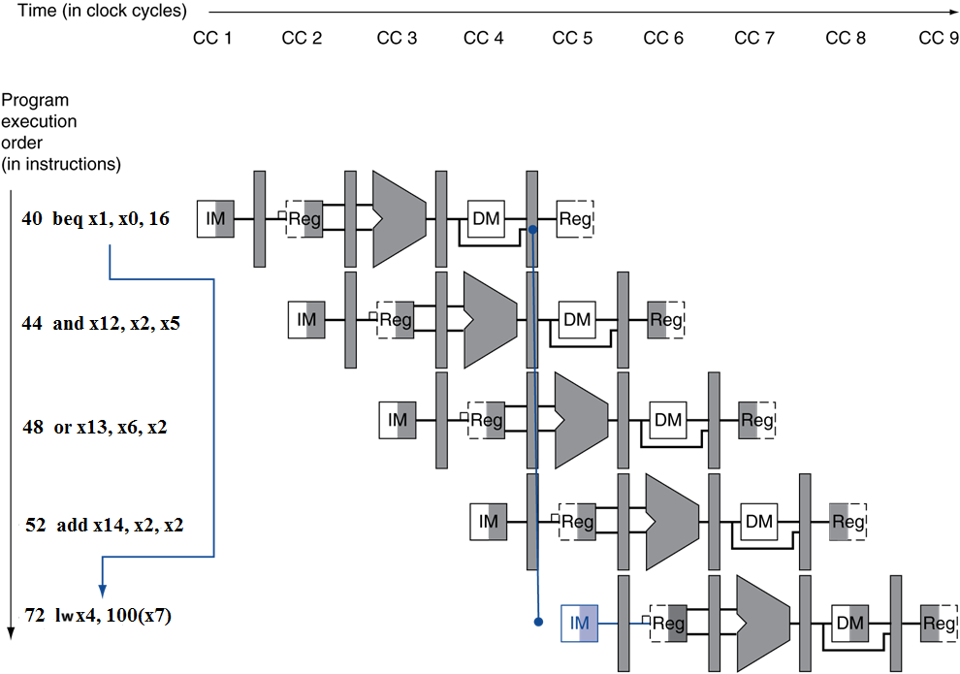
Branch Hazards
If branch outcome determined in MEM
§4.9 Control Hazards
Flush these
instructions
(Set control
values to 0)
PC

Slide 83
Reducing Branch Delay
Move hardware to determine outcome to ID stage
  Target address adder
  Register comparator
Example: branch taken
  36: sub x10, x4, x8
  40: beq x1, x3, 16 //PC-relative branch to 40+16*2=72
  44: and x12, x2, x5
  48: or x13, x2, x6
  52: add x14, x4, x2
  56: sub x15, x6, x7
  ...
  72: lw x4, 50(x7)

Slide 84
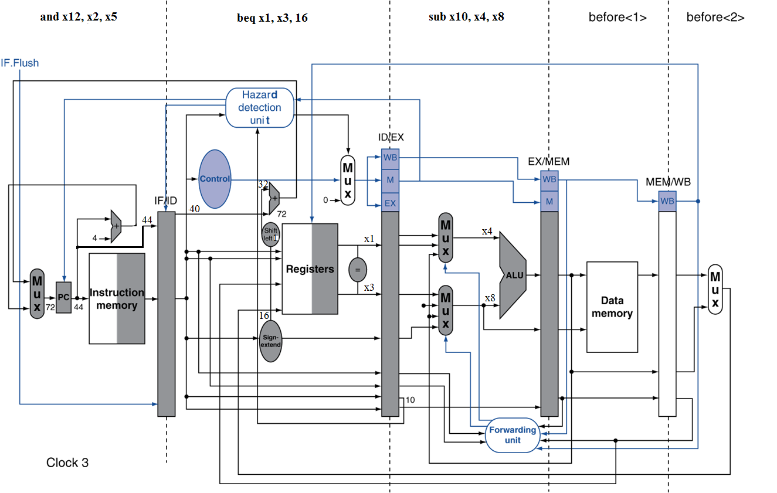
Example: Branch Taken

Slide 85
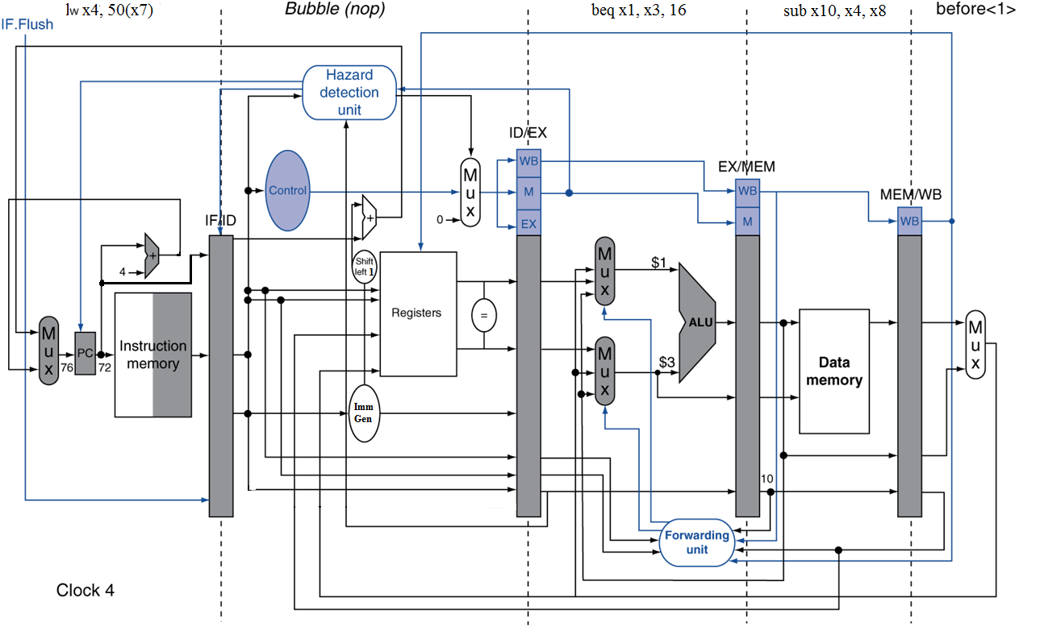
Example: Branch Taken

Slide 86
Data Hazards for Branches
If a comparison register is a destination of 2nd or 3rd preceding ALU instruction
add x1, x2, x3
IF
ID
EX
MEM
WB
add x4, x5, x6
IF
ID
EX
MEM
WB
…
IF
ID
EX
MEM
WB
beq x1, x4, target
IF
ID
EX
MEM
WB
Can resolve using forwarding

Slide 87
Data Hazards for Branches
If a comparison register is a destination of preceding ALU instruction or 2nd preceding load instruction
  Need 1 stall cycle
lw x1, addr
IF
ID
EX
MEM
WB
add x4, x5, x6
IF
ID
EX
MEM
WB
beq stalled
IF
ID
beq x1, x4, target
ID
EX
MEM
WB

Slide 88
Data Hazards for Branches
If a comparison register is a destination of immediately preceding load instruction
  Need 2 stall cycles
lw x1, addr
IF
ID
EX
MEM
WB
beq stalled
IF
ID
beq stalled
ID
beq x1, x0, target
ID
EX
MEM
WB

Slide 89
Dynamic Branch Prediction
In deeper and superscalar pipelines, branch penalty is more significant
Use dynamic prediction
  Branch prediction buffer (aka branch history table)
  Indexed by recent branch instruction addresses
  Stores outcome (taken/not taken)
  To execute a branch
    Check table, expect the same outcome
    Start fetching from fall-through or target
    If wrong, flush pipeline and flip prediction

Slide 90
1-Bit Predictor: Shortcoming
Inner loop branches mispredicted twice!
outer: …
…
inner: …
…
beq …, …, inner
…
beq …, …, outer
  Mispredict as taken on last iteration of inner loop
  Then mispredict as not taken on first iteration of inner loop next time around

Slide 91
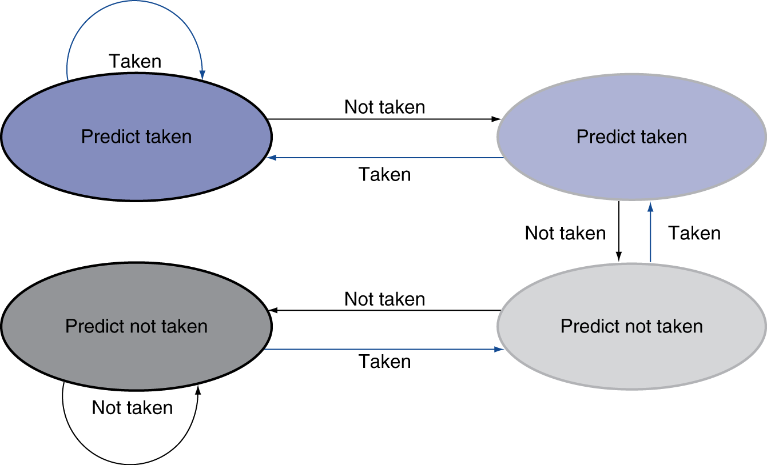
2-Bit Predictor
Only change prediction on two successive mispredictions

Slide 92
Calculating the Branch Target
Even with predictor, still need to calculate the target address
  1-cycle penalty for a taken branch
Branch target buffer
  Cache of target addresses
  Indexed by PC when instruction fetched
    If hit and instruction is branch predicted taken, can fetch target immediately

Slide 93
Delayed Branches
If the branch hardware has been moved to the ID stage, then we can eliminate all branch stalls with delayed branches which are defined as always executing the next sequential instruction after the branch instruction – the branch takes effect after that next instruction
  MIPS compiler moves an instruction to immediately after the branch that is not affected by the branch (a safe instruction) thereby hiding the branch delay
With deeper pipelines, the branch delay grows requiring more than one delay slot
  Delayed branches have lost popularity compared to more expensive but more flexible (dynamic) hardware branch prediction
  Growth in available transistors has made hardware branch prediction relatively cheaper
Notes:
No processor uses delayed branches of more than 1 cycle.
For longer branch delays, hardware-based branch prediction is used.

Slide 94
Exceptions and Interrupts
§4.10 Exceptions
“Unexpected” events requiring change
in flow of control
  Different ISAs use the terms differently
Exception
  Arises within the CPU
    e.g., undefined opcode, overflow, syscall, …
Interrupt
  From an external I/O controller
Dealing with them without sacrificing performance is hard

Slide 95
Handling Exceptions
Save PC of offending (or interrupted) instruction
  In RISC-V: Supervisor Exception Program Counter (SEPC)
Save indication of the problem
  In RISC-V : Cause register (SCAUSE)
  We’ll assume 1-bit
    0 for undefined instruction, 1 for system error
Jump to handler at 0000 0000 1C09 0000

Slide 96
An Alternate Mechanism
Vectored Interrupts
  Handler address determined by the cause
Example:
  Undefined instruction: 00 0100 0000
  System error: 01 1000 0000
  …: 11 1000 0000
Jump to real handler by the cause of the exception

Slide 97
Handler Actions
Read cause, and transfer to relevant handler
Determine action required
If restartable
  Take corrective action
  use SEPC to return to program
Otherwise
  Terminate program
  Report error using SEPC, cause, …

Slide 98
Exceptions in a Pipeline
Another form of control hazard
Consider overflow on add in EX stage
  add x1, x2, x1
  Prevent x1 from being clobbered
  Complete previous instructions
  Flush add and subsequent instructions
  Set Cause and SEPC register values
  Transfer control to handler
Similar to mispredicted branch
  Use much of the same hardware

Slide 99
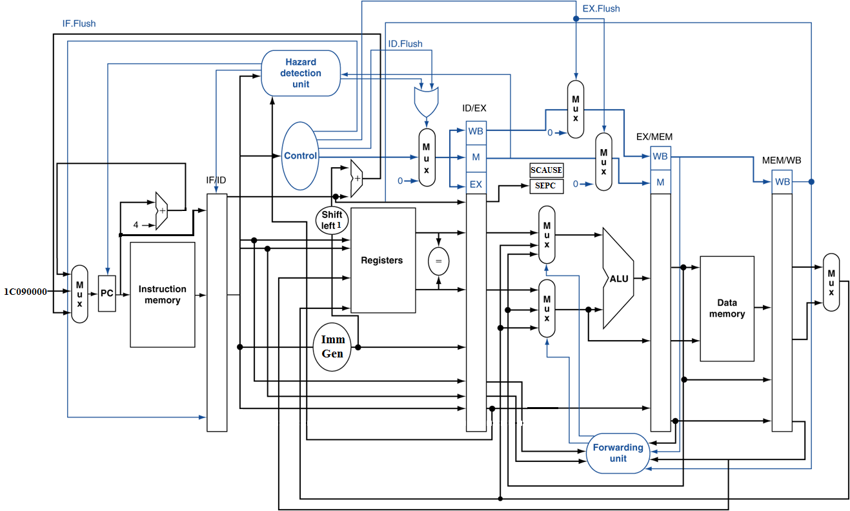
Pipeline with Exceptions

Slide 100
Exception Properties
Restartable exceptions
  Pipeline can flush the instruction
  Handler executes, then returns to the instruction
    Refetched and executed from scratch
PC saved in SEPC register
SCAUSE register records the highest priority exception

Slide 101
Multiple Exceptions
Pipelining overlaps multiple instructions
  Could have multiple exceptions at once
Simple approach: deal with exception from earliest instruction
  Flush subsequent instructions
  “Precise” exceptions
In complex pipelines
  Multiple instructions issued per cycle
  Out-of-order completion
  Maintaining precise exceptions is difficult!

Slide 102
Imprecise Exceptions
Just stop pipeline and save state
  Including exception cause(s)
Let the handler work out
  Which instruction(s) had exceptions
  Which to complete or flush
    May require “manual” completion
Simplifies hardware, but more complex handler software
Not feasible for complex multiple-issue
out-of-order pipelines

Slide 103
Instruction-Level Parallelism (ILP)
Pipelining: executing multiple instructions in parallel
To increase ILP
  Deeper pipeline
    Less work per stage ⇒ shorter clock cycle
  Multiple issue
    Replicate pipeline stages ⇒ multiple pipelines
    Start multiple instructions per clock cycle
    CPI < 1, so use Instructions Per Cycle (IPC)
    E.g., 4GHz 4-way multiple-issue
      16 BIPS, peak CPI = 0.25, peak IPC = 4
    But dependencies reduce this in practice
§4.11 Parallelism via Instructions

Slide 104
Multiple Issue
Static multiple issue
  Compiler groups instructions to be issued together
  Packages them into “issue slots”
  Compiler detects and avoids hazards
Dynamic multiple issue
  CPU examines instruction stream and chooses instructions to issue each cycle
  Compiler can help by reordering instructions
  CPU resolves hazards using advanced techniques at runtime

Slide 105
Speculation
“Guess” what to do with an instruction
  Start operation as soon as possible
  Check whether guess was right
    If so, complete the operation
    If not, roll-back and do the right thing
Common to static and dynamic multiple issue
Examples
  Speculate on branch outcome
    Roll back if path taken is different
  Speculate on load
    Roll back if location is updated

Slide 106
Compiler/Hardware Speculation
Compiler can reorder instructions
  e.g., move load before branch
  Can include “fix-up” instructions to recover from incorrect guess
Hardware can look ahead for instructions to execute
  Buffer results until it determines they are actually needed
  Flush buffers on incorrect speculation

Slide 107
Speculation and Exceptions
What if exception occurs on a speculatively executed instruction?
  e.g., speculative load before null-pointer check
Static speculation
  Can add ISA support for deferring exceptions
Dynamic speculation
  Can buffer exceptions until instruction completion (which may not occur)

Slide 108
Static Multiple Issue
Compiler groups instructions into “issue packets”
  Group of instructions that can be issued on a single cycle
  Determined by pipeline resources required
Think of an issue packet as a very long instruction
  Specifies multiple concurrent operations
  ⇒ Very Long Instruction Word (VLIW)

Slide 109
Scheduling Static Multiple Issue
Compiler must remove some/all hazards
  Reorder instructions into issue packets
  No dependencies with a packet
  Possibly some dependencies between packets
    Varies between ISAs; compiler must know!
  Pad with nop if necessary

Slide 110
RISC-V with Static Dual Issue
Two-issue packets
  One ALU/branch instruction
  One load/store instruction
  64-bit aligned
    ALU/branch, then load/store
    Pad an unused instruction with nop
Address | Instruction type | Pipeline Stages
n | ALU/branch | IF | ID | EX | MEM | WB
n + 4 | Load/store | IF | ID | EX | MEM | WB
n + 8 | ALU/branch |  | IF | ID | EX | MEM | WB
n + 12 | Load/store |  | IF | ID | EX | MEM | WB
n + 16 | ALU/branch |  |  | IF | ID | EX | MEM | WB
n + 20 | Load/store |  |  | IF | ID | EX | MEM | WB

Slide 111
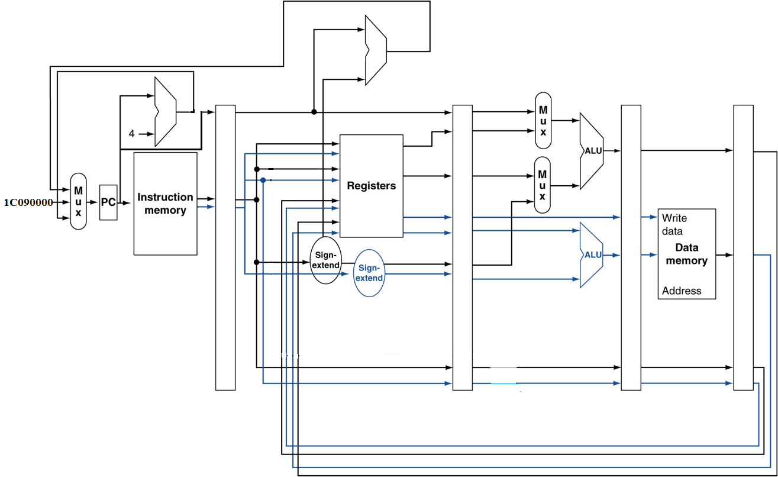
RISC-V with Static Dual Issue

Slide 112
Hazards in the Dual-Issue RISC-V
More instructions executing in parallel
EX data hazard
  Forwarding avoided stalls with single-issue
  Now can’t use ALU result in load/store in same packet
    add x5, x0, x1
    lw x2, 0(x5)
    Split into two packets, effectively a stall
Load-use hazard
  Still one cycle use latency, but now two instructions
More aggressive scheduling required

Slide 113
Scheduling Example
Schedule this for dual-issue RISC-V
Loop: lw x31, 0(x20) // x31=array element
add x31, x31, x21 // add scalar in x21
sw x31, 4(x20) // store result
addi x20, x20,–4 // decrement pointer
blt x22, x20, Loop // branch if x20 > x22
 | ALU/branch | Load/store | cycle
Loop: | nop | lw x31, 0(x20) | 1
 | addi x20, x20, –4 | nop | 2
 | Add x31, x31, x21 | nop | 3
 | blt x22, x20, Loop | sw x31, 4(x20) | 4
  IPC = 5/4 = 1.25 (c.f. peak IPC = 2)

Slide 114
Loop Unrolling
Replicate loop body to expose more parallelism
  Reduces loop-control overhead
Use different registers per replication
  Called “register renaming”
  Avoid loop-carried “anti-dependencies”
    Store followed by a load of the same register
    Aka “name dependence”
      Reuse of a register name

Slide 115
Loop Unrolling Example
 | ALU/branch | Load/store | cycle
Loop: | addi x20, x20,–16 | lw x28, 0(x20) | 1
 | nop | lw x29, 12(x20) | 2
 | add x28, x28, x21 | lw x30, 8(x20) | 3
 | add x29, x29, x21 | lw x31, 4(x20) | 4
 | add x30, x30, x21 | sw x28, 16(x20) | 5
 | add x31, x31, x21 | sw x29, 12(x20) | 6
 | nop | sw x30, 8(x20) | 7
 | blt x22, x20, Loop | sw x31, 4(x20) | 8
IPC = 14/8 = 1.75
  Closer to 2, but at cost of registers and code size

Slide 116
Dynamic Multiple Issue
“Superscalar” processors
CPU decides whether to issue 0, 1, 2, … each cycle
  Avoiding structural and data hazards
Avoids the need for compiler scheduling
  Though it may still help
  Code semantics ensured by the CPU

Slide 117
Dynamic Pipeline Scheduling
Allow the CPU to execute instructions out of order to avoid stalls
  But commit result to registers in order
Example
  lw x31, 0(x21)
  add x1, x31, x2
  sub x23, x23, x3
  andi x5, x23, 20
  Can start sub while add is waiting for lw

Slide 118
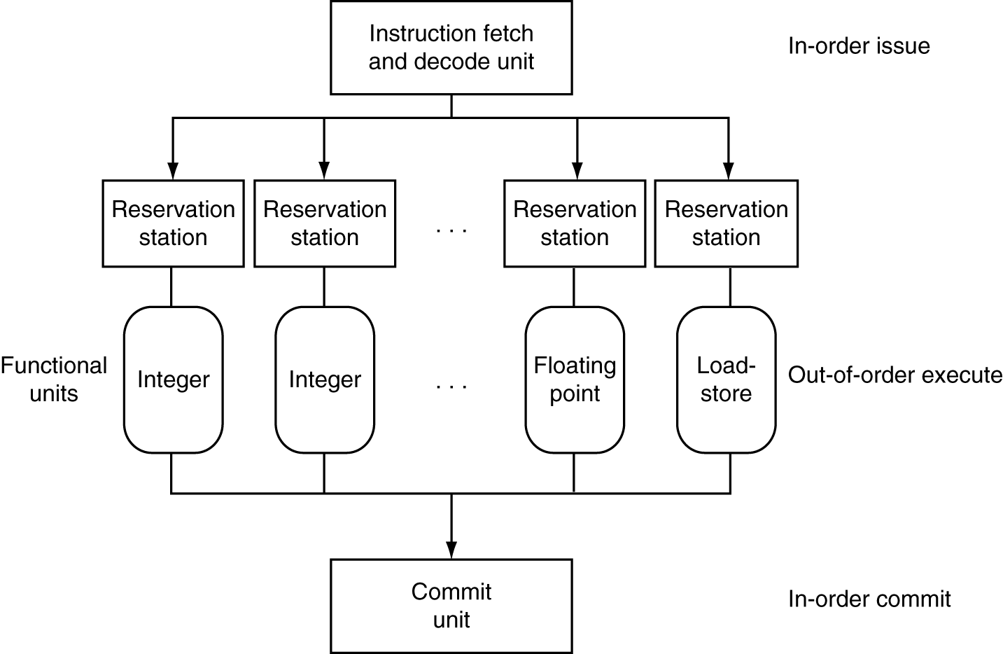
Dynamically Scheduled CPU
Preserves dependencies
Hold pending operands
Results also sent to any waiting reservation stations
Reorders buffer for register writes
Can supply operands for issued instructions

Slide 119
Register Renaming
Reservation stations and reorder buffer effectively provide register renaming
On instruction issue to reservation station
  If operand is available in register file or reorder buffer
    Copied to reservation station
    No longer required in the register; can be overwritten
  If operand is not yet available
    It will be provided to the reservation station by a function unit
    Register update may not be required

Slide 120
Speculation
Predict branch and continue issuing
  Don’t commit until branch outcome determined
Load speculation
  Avoid load and cache miss delay
    Predict the effective address
    Predict loaded value
    Load before completing outstanding stores
    Bypass stored values to load unit
  Don’t commit load until speculation cleared

Slide 121
Why Do Dynamic Scheduling?
Why not just let the compiler schedule code?
Not all stalls are predicable
  e.g., cache misses
Can’t always schedule around branches
  Branch outcome is dynamically determined
Different implementations of an ISA have different latencies and hazards

Slide 122
Does Multiple Issue Work?
The BIG Picture
Yes, but not as much as we’d like
Programs have real dependencies that limit ILP
Some dependencies are hard to eliminate
  e.g., pointer aliasing
Some parallelism is hard to expose
  Limited window size during instruction issue
Memory delays and limited bandwidth
  Hard to keep pipelines full
Speculation can help if done well

Slide 123
Power Efficiency
Complexity of dynamic scheduling and speculations requires power
Multiple simpler cores may be better
Microprocessor | Year | Clock Rate | Pipeline Stages | Issue width | Out-of-order/ Speculation | Cores | Power
i486 | 1989 | 25MHz | 5 | 1 | No | 1 | 5W
Pentium | 1993 | 66MHz | 5 | 2 | No | 1 | 10W
Pentium Pro | 1997 | 200MHz | 10 | 3 | Yes | 1 | 29W
P4 Willamette | 2001 | 2000MHz | 22 | 3 | Yes | 1 | 75W
P4 Prescott | 2004 | 3600MHz | 31 | 3 | Yes | 1 | 103W
Core | 2006 | 2930MHz | 14 | 4 | Yes | 2 | 75W
UltraSparc III | 2003 | 1950MHz | 14 | 4 | No | 1 | 90W
UltraSparc T1 | 2005 | 1200MHz | 6 | 1 | No | 8 | 70W

Slide 124
Concluding Remarks
ISA influences design of datapath and control
Datapath and control influence design of ISA
Pipelining improves instruction throughput
using parallelism
  More instructions completed per second
  Latency for each instruction not reduced
Hazards: structural, data, control
Multiple issue and dynamic scheduling (ILP)
  Dependencies limit achievable parallelism
  Complexity leads to the power wall
§4.15 Concluding Remarks

